Slide 1
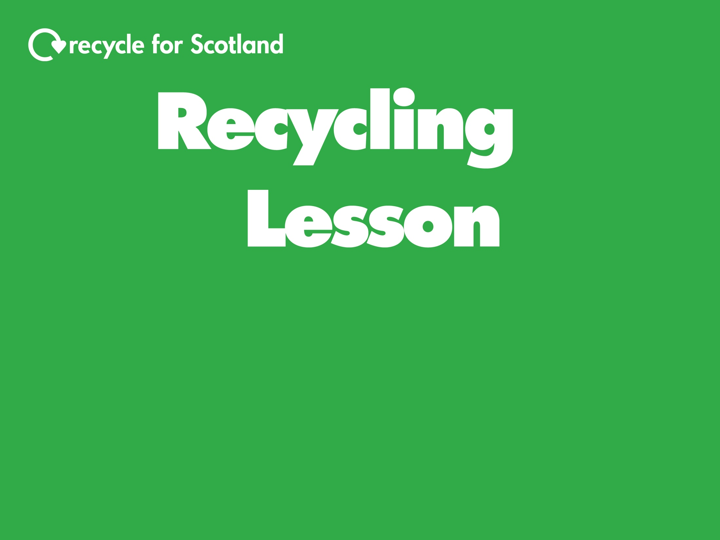
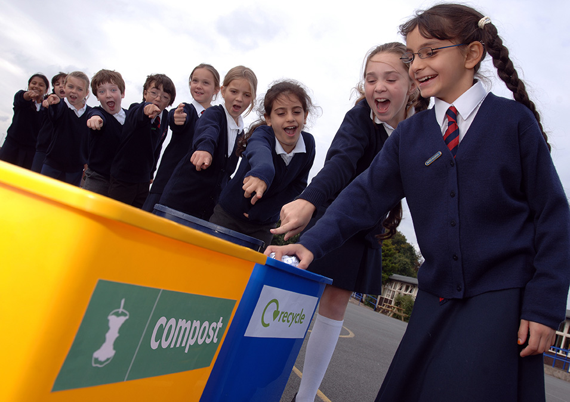

Slide 2
Learning Intentions
Success Criteria
To understand why we should recycle
Describe what recycling is
Explain how recycling is good for the environment
To identify at least 5 items that we can recycle
Participate in the ‘what can I recycle?’ game and recycling quiz
To know what happens to at least 2 items when they are recycled
Watch the ‘recycling journey’ videos
Participate in the recycling quiz

Slide 3
Can you name at least 3 items that you can recycle at home?
What do you think your cans become when they are recycled?
Can you think of a reason why we should recycle?

Slide 4
What does ‘recycle’ mean?
To recycle an item means to use the item to make something new.
Have you seen this symbol before?
If you see this symbol on packaging there will be information on recycling.

Slide 5
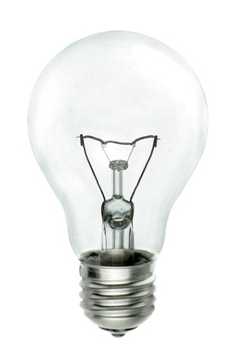
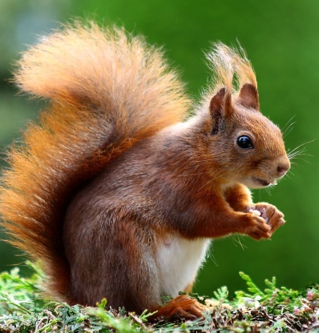
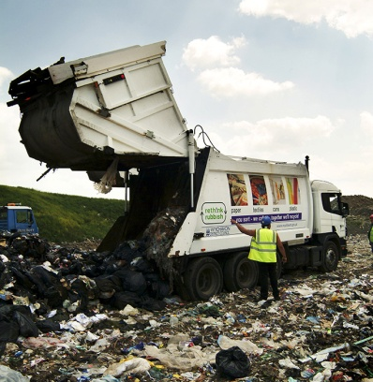
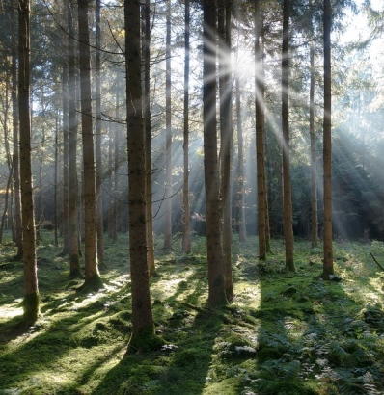
Why should we recycle?
Saves resources
Saves energy
Protects the environment
Reduces landfill
Notes:
Images
Forest: https://pixabay.com/en/spruce-forest-conifer-tree-nature-1018606/
Bulb: https://pixabay.com/en/bulb-electricity-energy-glass-lamp-546859/
Squirrel: https://pixabay.com/en/squirrel-animal-cute-rodents-493790/
Landfill: https://partners.wrap.org.uk/assets/7721/

Slide 6
At home you may have your own bins and containers or you may share bins and containers with your neighbours.
You can recycle:
Can you think of things you throw away that are made of these materials?
Notes:
Images
Mixed paper & card: https://partners.wrap.org.uk/assets/4020/
Mixed glass bottles & jars: https://partners.wrap.org.uk/assets/2818/
Food tins & drink cans: https://partners.wrap.org.uk/assets/2925/
Plastic bottles: https://partners.wrap.org.uk/assets/3001/

Slide 7
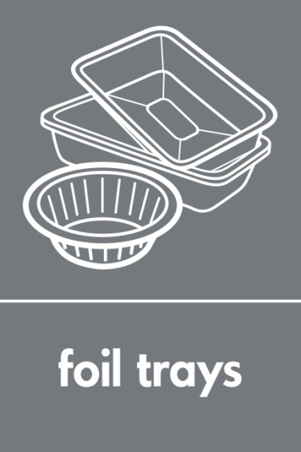
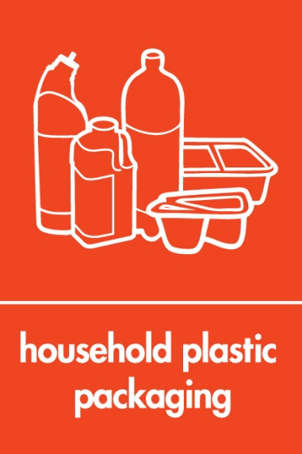
You may also be able to recycle:
Notes:
Images
Aerosols: https://partners.wrap.org.uk/assets/2943/
Cartons: https://partners.wrap.org.uk/assets/2860/
Foil trays: https://partners.wrap.org.uk/assets/2986/
Household plastic packaging: https://partners.wrap.org.uk/assets/3019/
Food waste: https://partners.wrap.org.uk/assets/9386/

Slide 8
Can you identify items that you can recycle around your home?
The class will be split into two groups.
A picture of a room will appear on the screen.
Each group will write down as many items as they can and the material it is made of e.g. shampoo bottle, plastic.
You will have 1 minute per room.
1 point will be awarded for each room to the group with the most correct answers.
The group with the most points at the end wins!
Ready? Here we go...

Slide 10
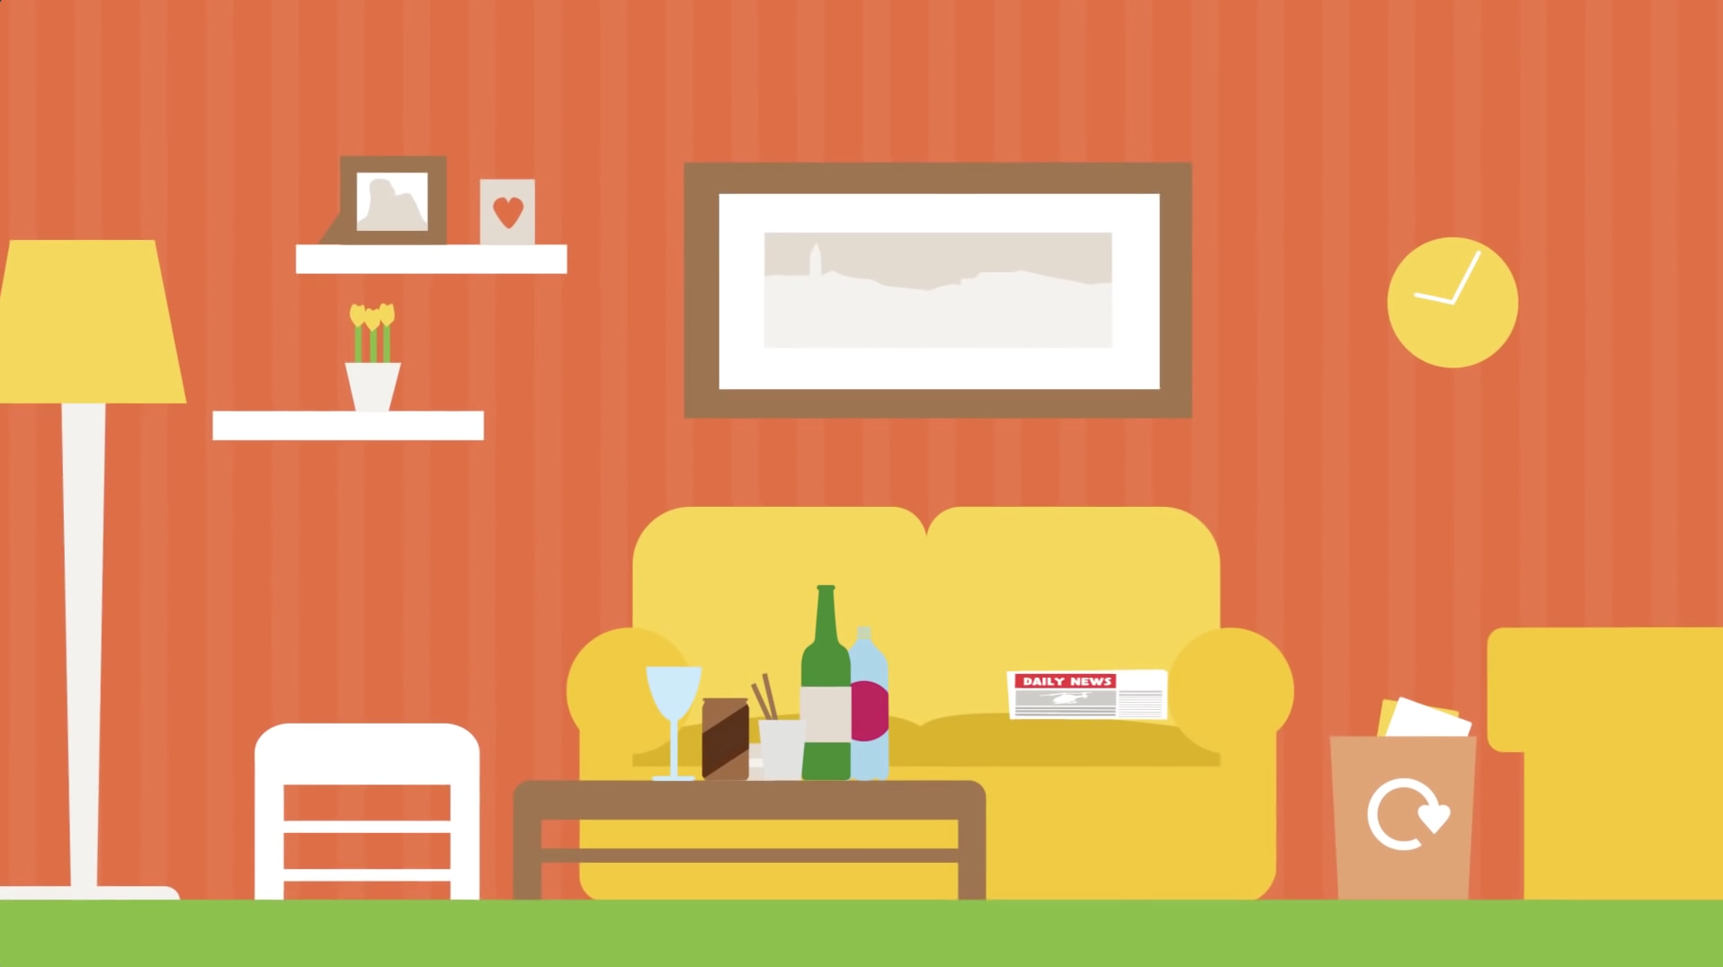

Slide 11
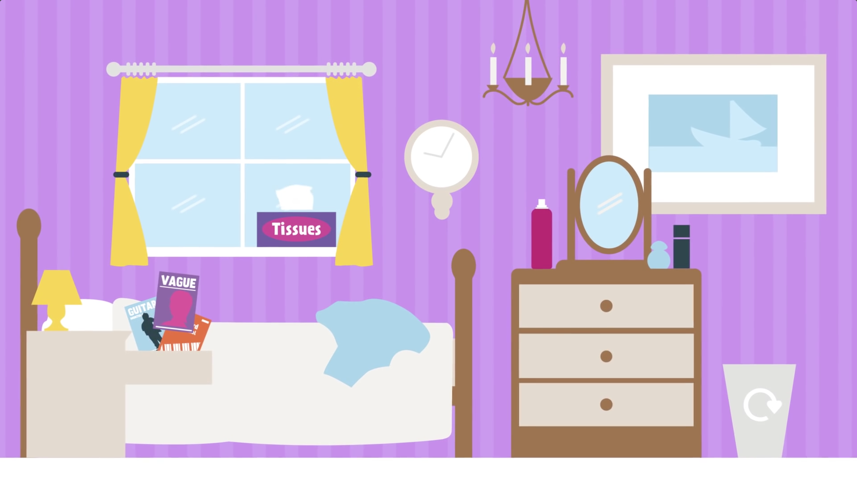

Slide 12
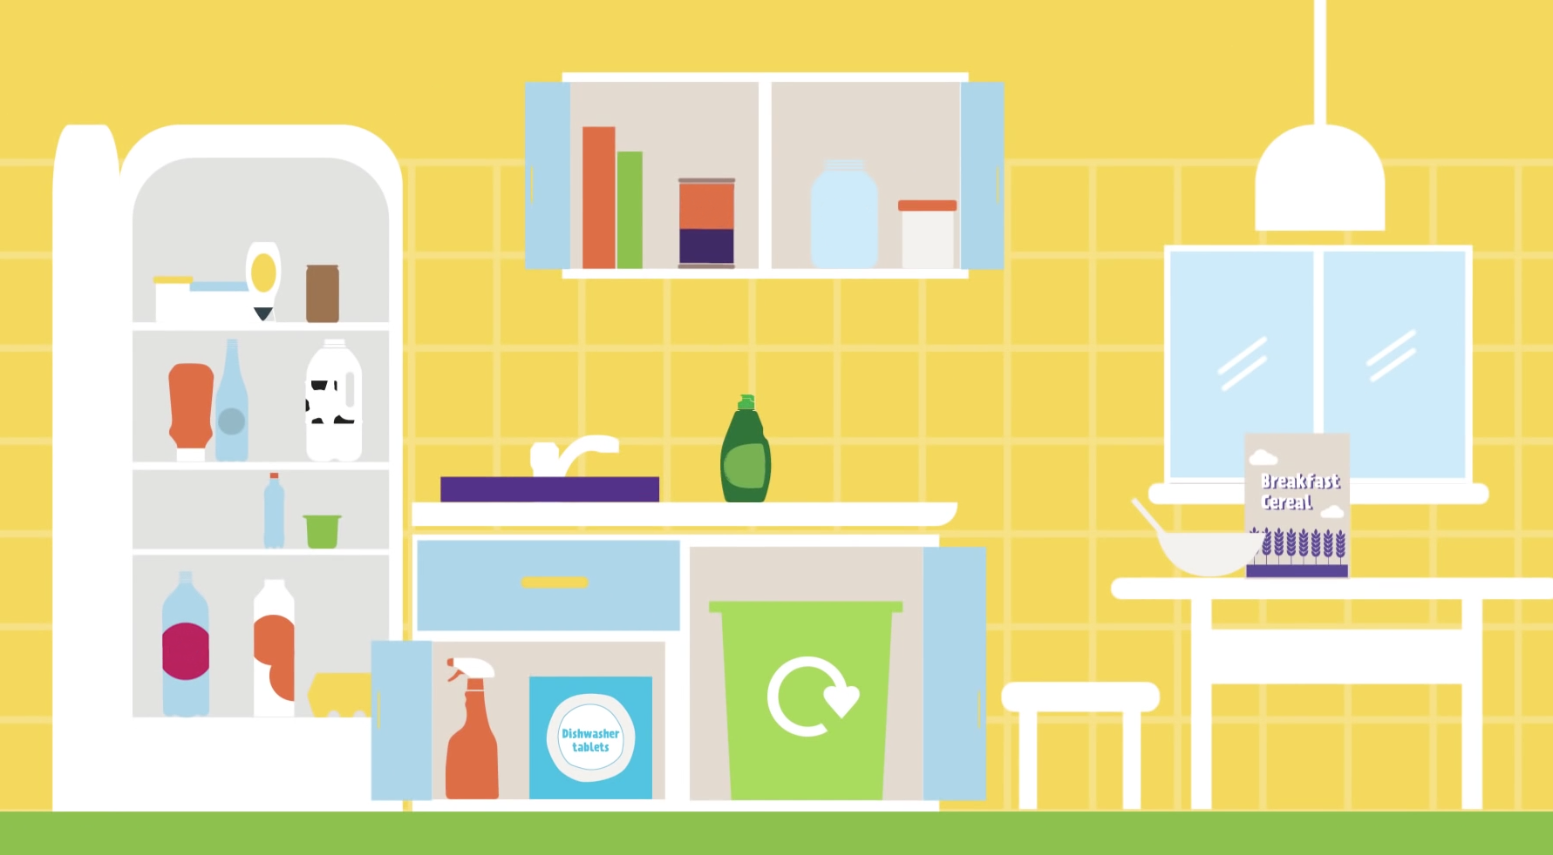

Slide 13
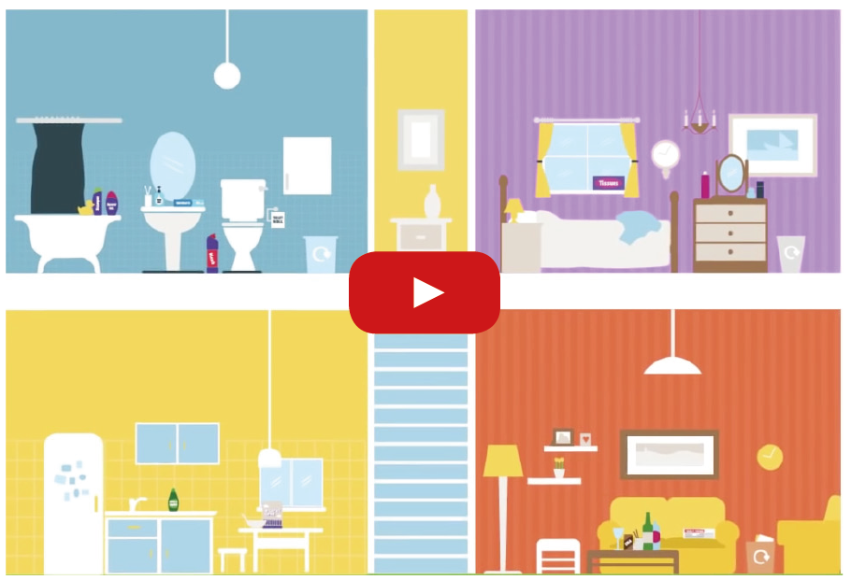
Now watch this short video.
See what you can recycle around the home and why it’s important to recycle.
Access video here: http://www.recycleforscotland.com/are-you-recycling-everything-you-can
Notes:
http://www.recycleforscotland.com/are-you-recycling-everything-you-can

Slide 14
Watch the video.
Discover what happens to cans when they are recycled.
Try to answer the question!
Access video here: http://www.recycleforscotland.com/facts-figures/how-it-recycled/cans
Notes:
http://www.recycleforscotland.com/facts-figures/how-it-recycled/cans

Slide 15
Q: How quickly can a drink can be recycled and appear back on a store shelf?
A: Just 6 weeks!

Slide 16
Watch the video.
Discover what happens to plastic when it is recycled.
Try to answer the question!
Access video here: http://www.recycleforscotland.com/facts-figures/how-it-recycled/plastics
Notes:
http://www.recycleforscotland.com/facts-figures/how-it-recycled/plastics

Slide 17
Q: What can recycled plastic be used to make?
A: Fleeces, shirts, toys, chairs, picnic benches, plastic bottles, etc.

Slide 18
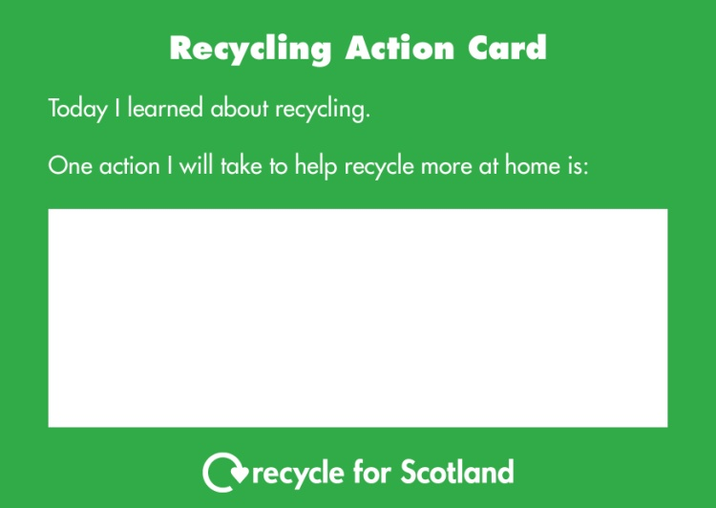
What could you do to help recycle more at home?
Complete an action card by writing at least one action.
Take this card home to show your parent(s) / carer(s).
Next week we can see how everyone is getting on with their actions.

Slide 19
Why do you think everyone should recycle?
Name 5 items that you can recycle from your home.
Choose 2 items that you can recycle.
Briefly describe what happens to these items when they are recycled.

Slide 20
Learning Intentions
Success Criteria
To understand why we should recycle
Describe what recycling is
Explain how recycling is good for the environment
To identify at least 5 items that we can recycle
Participate in the ‘what can I recycle?’ game and recycling quiz
To know what happens to at least 2 items when they are recycled
Watch the ‘recycling journey’ videos
Participate in the recycling quiz

Slide 21
Notes:
Image
Children recycling: https://partners.wrap.org.uk/assets/8236/

