Slide 1
In Scotland, we throw away 600,000 tonnes of food every year from our homes.
Notes:
This PowerPoint is designed to set the scene for your learners and can be edited to suit the needs of your lesson.
The 600,000 tonnes figure refers to both avoidable and unavoidable food waste. Avoidable food waste is what this lesson focuses on and included food that could have been eaten. Unavoidable food waste includes things like apple cores, skins and peelings – in other words food that couldn’t have been eaten.

Slide 2
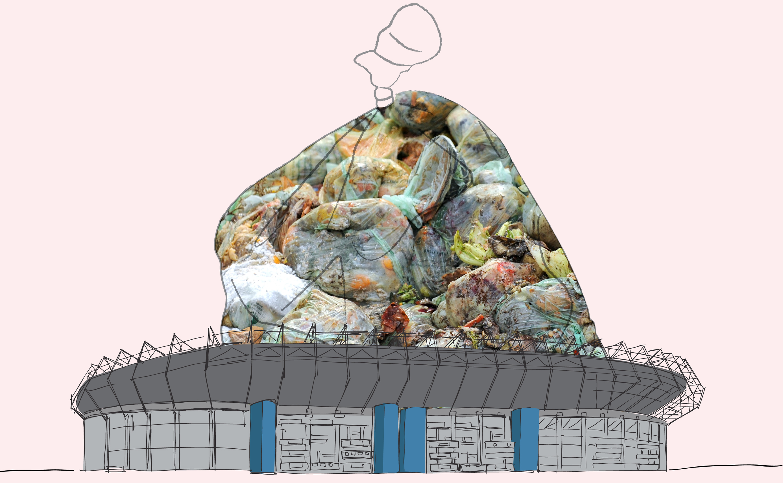
This is enough to fill up Murrayfield stadium 4 times over.
More than half of this is food that could have been eaten…
Notes:
‘More than half’ refers to the avoidable food waste as opposed to unavoidable food waste.
Ask your learners how big they think Murrayfield stadium is? Has anyone ever been?

Slide 3
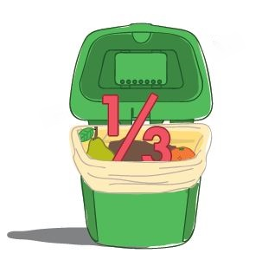
1/3 of food produced globally is lost or wasted…
Notes:
Roughly one third of the food produced in the world for human consumption every year — approximately 1.3 billion tonnes — gets lost or wasted.
For further information about food waste on a global scale please see the FAO website - http://www.fao.org/food-loss-and-food-waste/en/

Slide 4
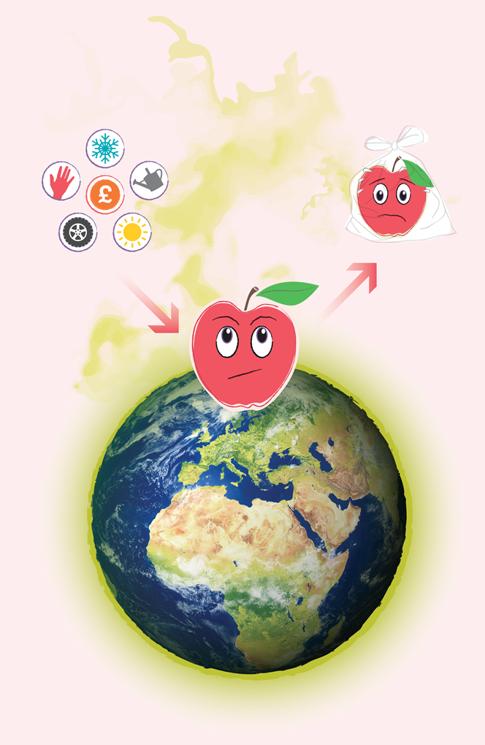
When we waste food, we waste all the energy and resources that go into producing it…
Wasted food also lets off harmful gases in landfill...
...this is bad for our environment.
Notes:
Have a discussion with your learners about how much effort goes into creating food. This could be in terms of the water used (12 liters is required to grow 1 tomato!), or the energy used to transport, store and package food, the land and soil space required, the human effort and impact.
If wasted food is put in the rubbish bin and goes to landfill it releases harmful greenhouse gases. If food waste is put in the food waste recycling bin these gases are captured and not released into the atmosphere. The level of detail required may be too much for your learners but the main point to stress is that wasted food lets off harmful gases in landfill which has a negative impact on our planet.

Slide 5
£90 million worth of bakery products are thrown out…
...we waste 2 million slices of bread a day.
Notes:
Scottish specific figures referring to what we waste in one year.

Slide 6
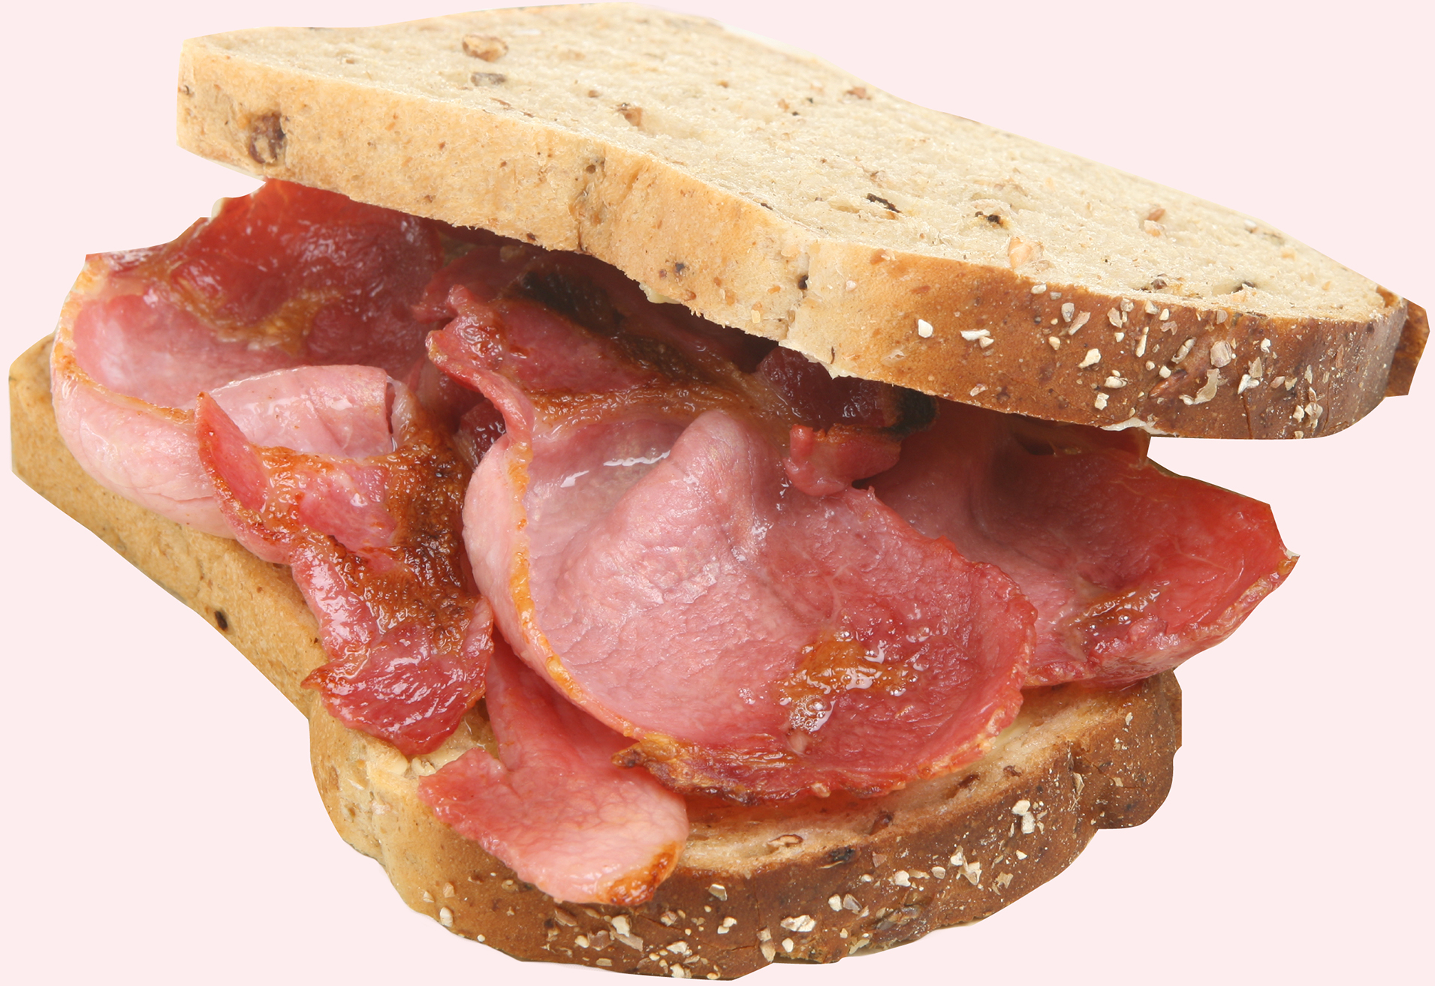
We waste £190 million worth of fresh meat & fish...
...enough to make everyone in Scotland a bacon buttie every Saturday for the next year.

Slide 7
We waste £79 million worth of fresh fruit...
...enough to give every learner and teacher in Scotland an apple a day for a year.

Slide 8
The average household could save £460 a year...
...enough for 46 trips to the cinema!
Notes:
This is the money that could be saved if the food was eaten instead of being thrown away. The average household in Scotland could save £460, for an individual this is £200 and for a family of 4 the potential savings rise to £700.
On a national level, Scottish households waste £1.1 billion worth of food every year.

Slide 9
A family of 4 could save £700 a year...
What would you buy with £700?

Slide 10
If we saved all the avoidable food waste from the bin in Scotland...
...it would have the same positive environmental impact as taking 1 in 4 cars off the road.
Notes:
This figure is calculated in terms of CO2 emissions and compares the gases emitted by food waste and the gases emitted by cars.
Draw on discussions from slide 4 to explain this point further.

Slide 11
The Scottish Government has pledged to reduce food waste in Scotland by 33%
by 2025...
...what can you do to help?
Notes:
Use this slide to link to the main focus of the lesson – how can language be used to persuade people? Ask your learners what would persuade them not to throw away food?
For more information on the Scottish Government target please see - http://www.zerowastescotland.org.uk/food-waste

