Slide 1
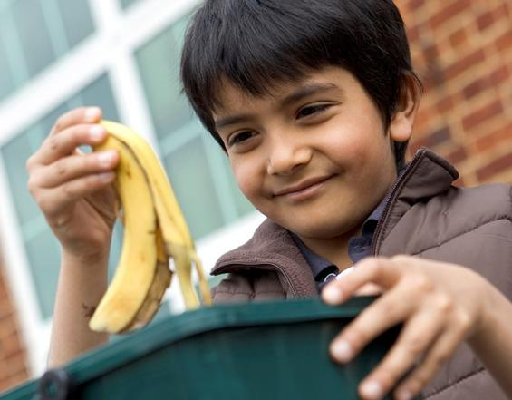
Notes:
Image:
Boy with food waste caddy - https://partners.wrap.org.uk/assets/7951/

Slide 2
Learning Intentions
Success Criteria
To understand why we should recycle food waste
Explain how food waste recycling is good for the environment/saves money
Participate in the ‘food waste recycling quiz’ and the bolt-on ‘food waste recycling game’
To identify at least 3 types of food waste that we can recycle
To know what happens to food waste when it is recycled
Participate in the ‘food waste recycling journey activity’ and the ‘food waste recycling quiz’

Slide 3
Can you name at least 2 types of food waste that you can recycle at home?
What do you think your food waste becomes when it is recycled?
Can you think of a reason why we should recycle food waste?

Slide 4
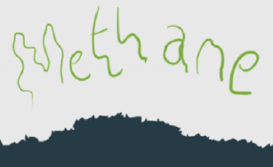
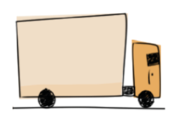
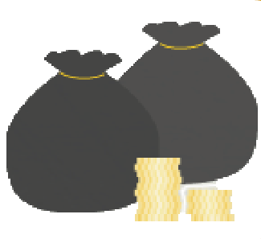
Why should we recycle food waste?
Reduces landfill
Saves resources
food
Saves money

Slide 5
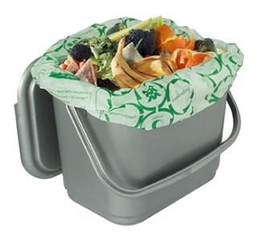
You can recycle food waste at home.
Cooked, uncooked and out-of-date food as well as peelings and leftovers can all be recycled.
Let’s see what types of food waste can go in the caddy.
Notes:
Image:
Food waste caddy - from https://partners.wrap.org.uk/assets/2590/

Slide 6
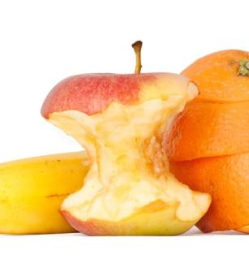
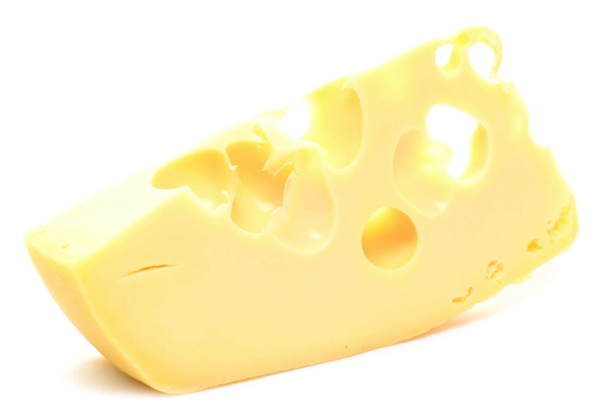
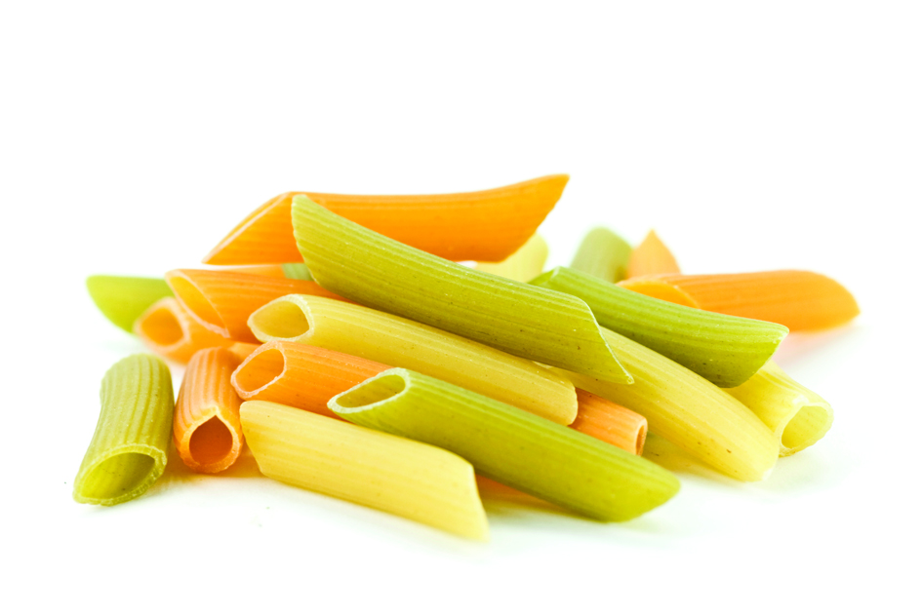
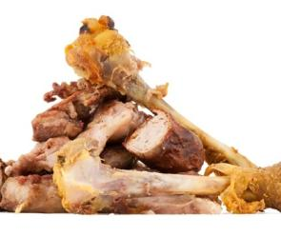
Dairy
Rice and pasta
Fruit including peelings
Chicken and bones

Slide 7
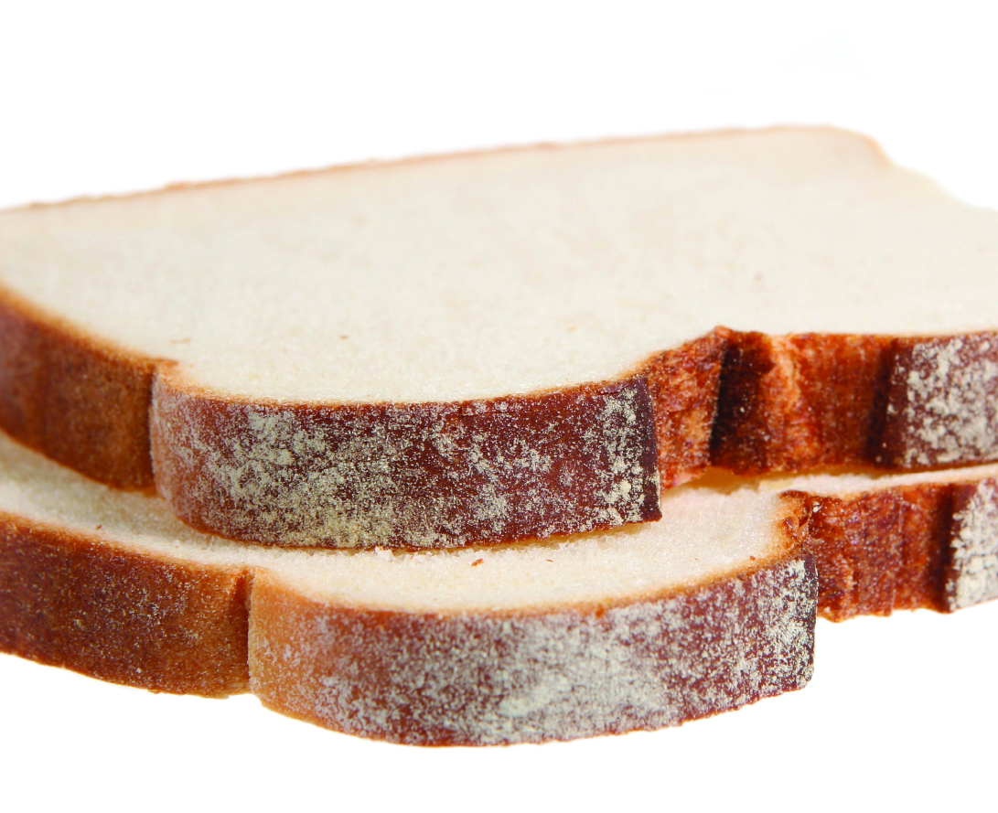
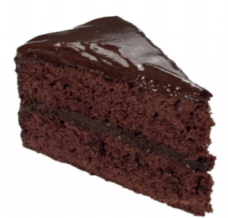
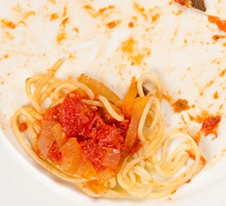
Fish
Plate scrapings/ Leftovers from meals
Bread
Cakes and pastries

Slide 8
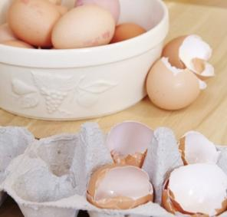
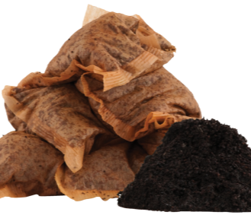
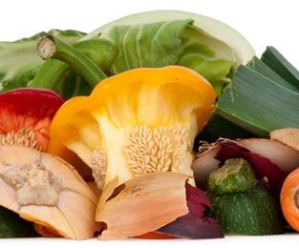
Eggshells
Meat
Teabags and coffee grounds
Vegetables including peelings

Slide 9
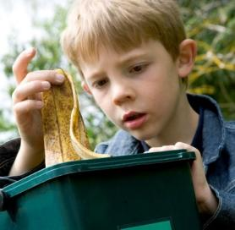
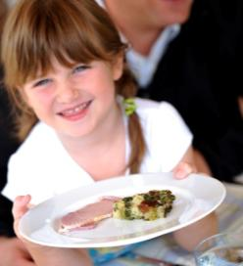
In groups of 3, answer these questions:
What did you eat yesterday?
What food did you leave?
How did you get rid of your food waste?
Are you surprised by how much food you waste?
Notes:
Images:
Boy with food waste caddy 2 - https://partners.wrap.org.uk/assets/7947/
Girl with meal - https://partners.wrap.org.uk/assets/8362/

Slide 10
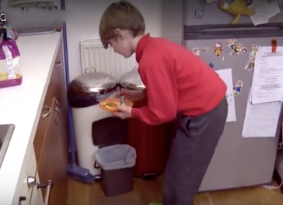
Now watch this short video.
See how you can recycle food waste at home.
Access video here: http://www.recyclenow.com/roisins-food-recycling-tip
Notes:
http://www.recyclenow.com/roisins-food-recycling-tip

Slide 11
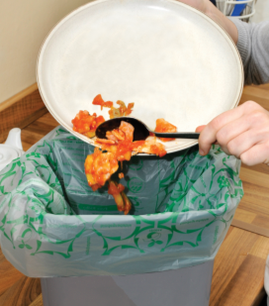
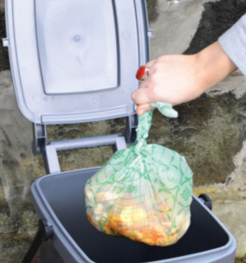
Step 1:
At home, put a new liner into your caddy.
Step 2:
Put food waste into your caddy.
Step 3:
When the liner is nearly full, tie and remove it.
Step 4:
Empty the full liner into your outdoor container regularly.

Slide 12
Watch the video.
Discover what happens to food waste when it is recycled.
See if you can track its journey!
Access video here: http://www.recycleforscotland.com/facts-figures/how-it-recycled/food-waste
Notes:
http://www.recycleforscotland.com/facts-figures/how-it-recycled/food-waste

Slide 13
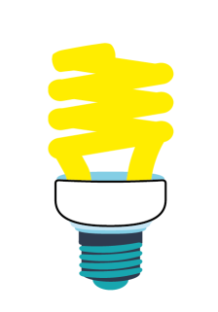
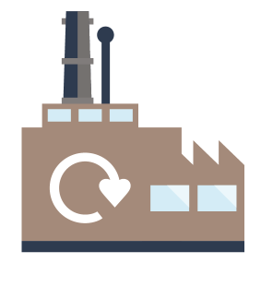
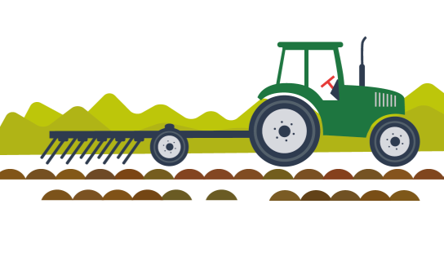
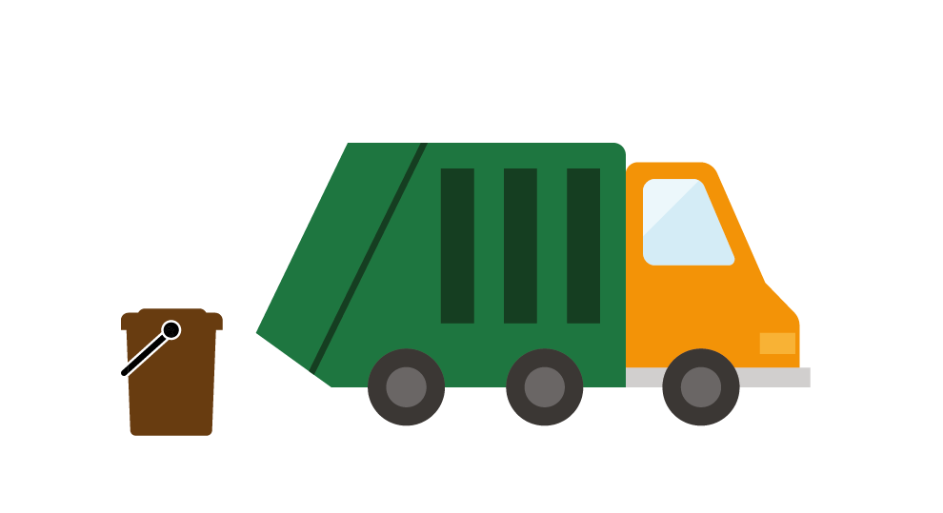
The steps of the journey are in the wrong order.
Put the letters of the pictures in the correct order.
Food waste is recycled into energy or fertiliser
A
Food waste is collected at the kerbside
B
Food waste is taken to a recycling facility
C

Slide 14
Check your answers. The correct order is:
Food waste is collected at the kerbside
B
Food waste is taken to a recycling facility
C
Food waste is recycled into energy or fertiliser
A

Slide 15
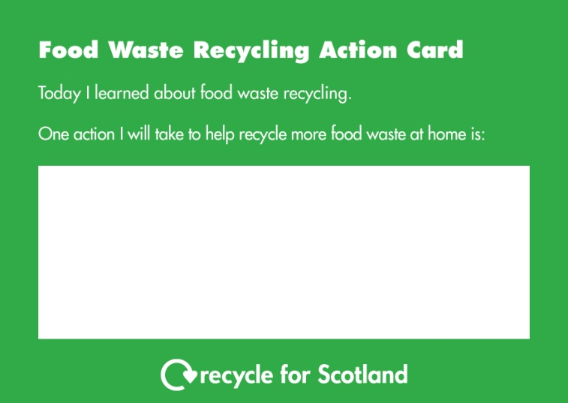
What could you do to help recycle more food waste at home?
Complete an action card by writing at least one action.
Take this card home to show your parent(s) / carer(s).
Next week we can see how everyone is getting on with their actions.

Slide 16
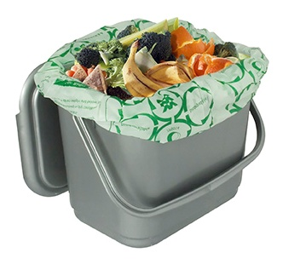
Why do you think we should recycle food waste?
Name 3 types of food waste that you can recycle in your home.
When food waste is recycled, what can it be recycled into?
Notes:
Image:
Food waste caddy - from https://partners.wrap.org.uk/assets/2590/

Slide 17
Learning Intentions
Success Criteria
To understand why we should recycle food waste
Explain how food waste recycling is good for the environment/saves money
Participate in the ‘food waste recycling quiz’ and the bolt-on ‘food waste recycling game’
To identify at least 3 types of food waste that we can recycle
To know what happens to food waste when it is recycled
Participate in the ‘food waste recycling journey activity’ and the ‘food waste recycling quiz’

Slide 18
Notes:
Image:
Boy with food waste caddy - https://partners.wrap.org.uk/assets/7951/

