Slide 1
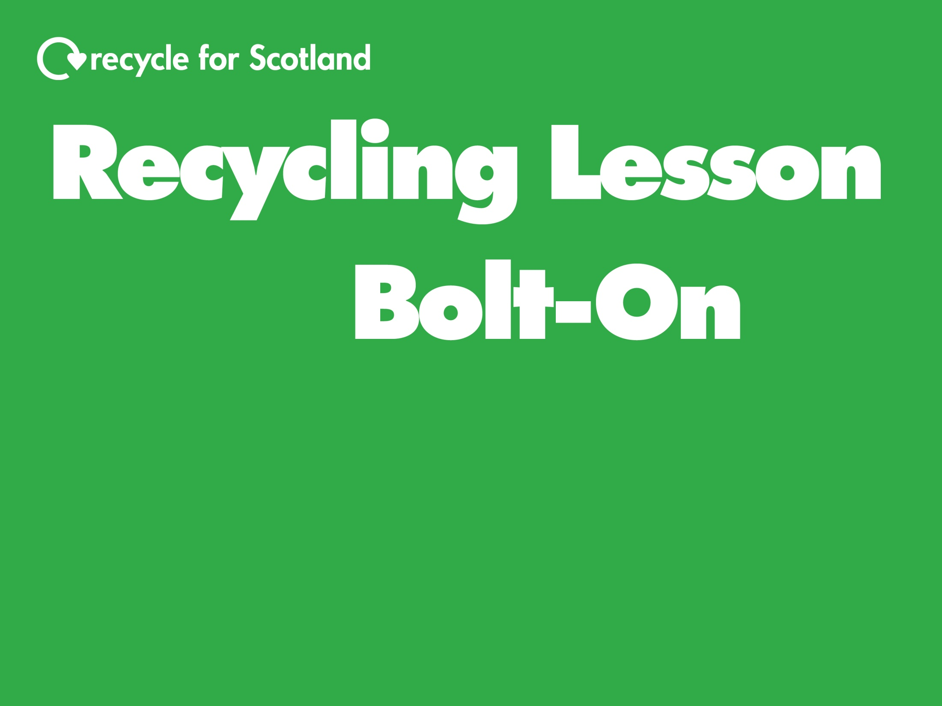
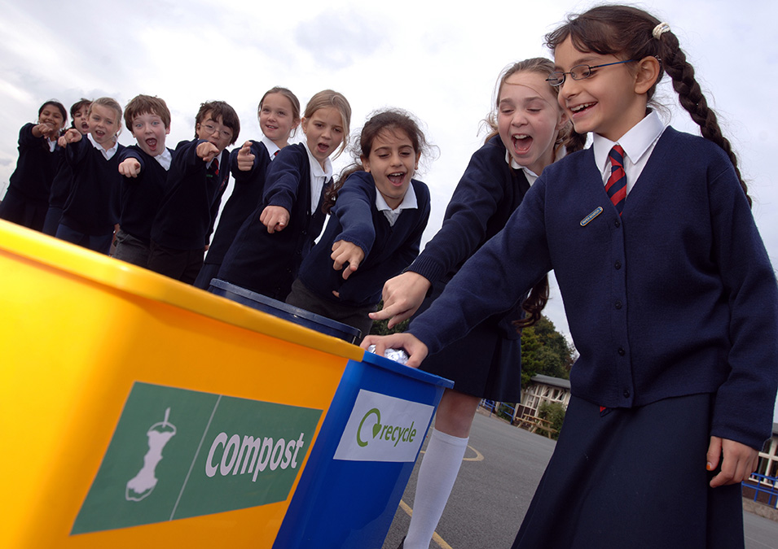

Slide 2
You will be numbered off 1 – 4.
4 recycling facts will appear on the screen.
You will have 5 minutes to draw a picture that describes your fact.
You will then show your picture and tell your fact to your partner.

Slide 3
1 An old newspaper can be recycled to make a new newspaper. |  |  | 2 Recycling plastic bottles saves energy.
3 Recycling cardboard saves trees. |  |  | 4 Drink cans can be made into bicycle frames.

Slide 4
Make sure your recycling is:
Emptied
Rinsed
Sorted
If you don’t, items may go to landfill and may not be recycled.

Slide 5
Reduce
Re-use
Recycle
Best
We’ve already discussed recycling, but it’s even better to reduce or re-use our waste.

Slide 6
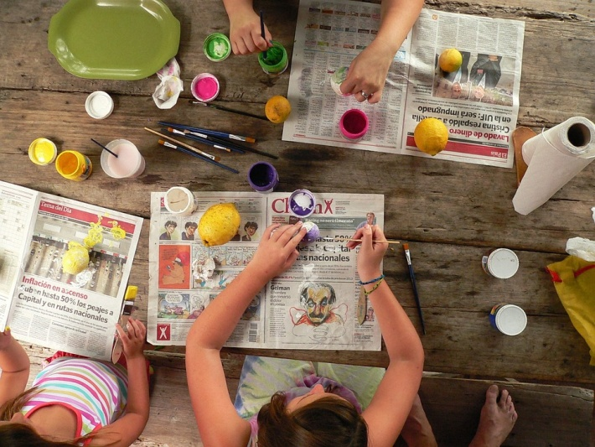
Reduce – Think before you buy
Instead of buying things, make them!
Can you think of your own example to reduce waste?
Notes:
Image
Children painting: https://pixabay.com/en/art-paint-painting-tempera-crafts-423530/

Slide 7
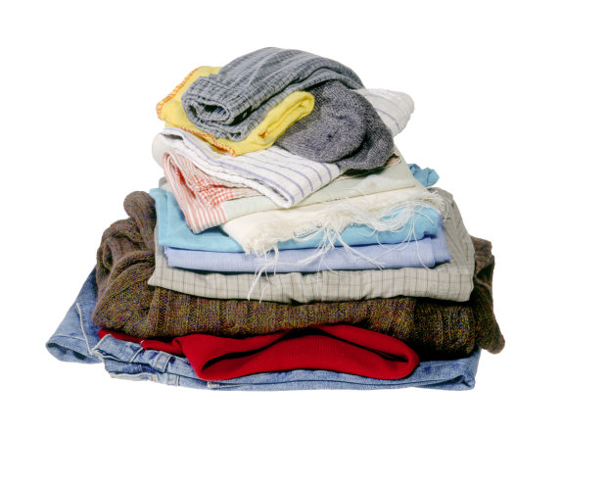
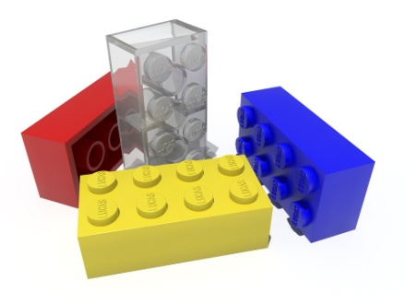
Re-use – Find ways to use things again
Pass on things you no longer want or need to someone else, swap with friends or take to a charity shop
Can you think of your own example to re-use?
clothing
toys
Notes:
Image
Clothing: https://partners.wrap.org.uk/assets/7074/
Lego: https://pixabay.com/en/lego-lego-blocks-stones-toys-615239/

Slide 8
What is one thing you should do with your recycling to make sure it doesn’t go to landfill?
Put these in order starting with the best for the environment:
reuse recycle reduce
What is one way that you can re-use an item?

Slide 9
Now complete the ‘Pupil Reflection’ in order to evaluate your learning and skills.
☺ 😐 ☹

Slide 10
Notes:
Image
Children recycling: https://partners.wrap.org.uk/assets/8236/

