Slide 1
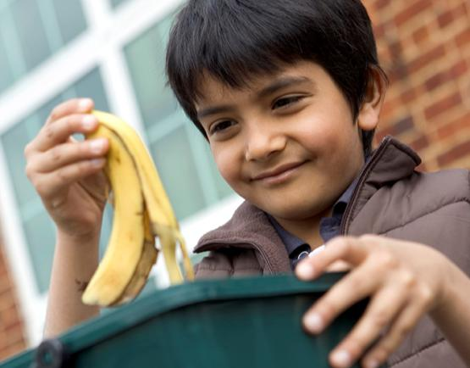

Slide 2
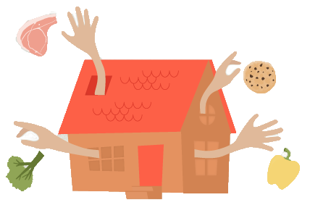
Did you know...
Almost half of the total amount of food we throw away in Scotland comes from our homes
We throw away 630,000 tonnes of food and drink from our homes every year
It costs the average home £470 a year!

Slide 3
Love Food Hate Waste has lots of hints and tips to help you and your family to better plan, portion and store your food, as well as lots of great recipes to help you use up your leftovers.
Visit http://scotland.lovefoodhatewaste.com/ to find out more.
Notes:
To discover top tips to reduce food waste, please visit:
http://scotland.lovefoodhatewaste.com/

Slide 4
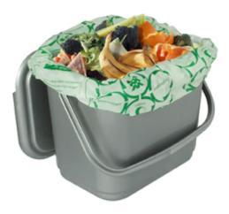
You will be numbered off 1 – 4.
4 food waste recycling facts will appear on the screen.
You will have 5 minutes to draw a picture that describes your fact.
You will then show your picture and tell your fact to your partner.
Notes:
Image:
Food waste caddy - from https://partners.wrap.org.uk/assets/2590/

Slide 5
1 1/3 of the world’s food is wasted. |  | 2 Every year in Scotland we throw away enough bread to make everyone a sandwich a day for the next 6 months.
3 Every year in Scotland we throw away enough meat to make everyone a bacon buttie every Saturday for the next year. |  | 4 If we all stop wasting food that could have been eaten, the benefit to the planet would be the same as taking 1 in 4 cars off the road.

Slide 6
Can you name types of food waste that you can recycle?
The class will be split into 4 groups.
As a group you will write down as many types of food waste that you can recycle as you can e.g. Eggshells.
The first group to correctly write 10 types wins!
Ready? Here we go...
Notes:
Image:
Pencil and memo pad - https://pixabay.com/en/notepad-memo-pencil-writing-note-117597/

Slide 7
Now complete the ‘Pupil Reflection’ in order to evaluate your learning and skills.
☺ 😐 ☹
Notes:
Image:
Food waste caddy - from https://partners.wrap.org.uk/assets/2590/

Slide 8
Notes:
Image:
Boy with food waste caddy - https://partners.wrap.org.uk/assets/7951/

