Slide 1
Zero Waste Scotland – LHEES Capacity Building Services
Stakeholder Engagement Toolkit
Prepared by Arup for Zero Waste Scotland
May 2023

Slide 2
Contents
Introduction (page 3)
Identify (page 6)
Map and Analyse (page 11)
Plan (page 17)
Engage (page 23)

Slide 3
Introduction
Purpose
This Stakeholder Engagement Toolkit aims to provide clear guidance and templates to enable Local Authorities (LAs) to complete stakeholder engagement as part of their Local Heat and Energy Efficiency Strategy (LHEES).
The LHEES Guidance sets out the engagement required at each Stage of the LHEES process; additionally, the LHEES Methodology starts to provide further detail on what engagement could look like in practice. This Toolkit focuses on providing further resources, particularly in relation to stakeholder engagement as part of Stage 1: Policy and Strategy Review, covered by the following sections of the LHEES Methodology:
Section 3.1.1 – The suggested approach to use the Policy and Strategy Review Template
Section 3.1.2 – Example approach for stakeholder engagement (identifying relevant stakeholders; mapping stakeholder; and developing engagement plans)
Section 3.1.3 – Engagement checklist for key stakeholders (excluding national level stakeholders)

Slide 4
Introduction
Who is involved
As set out in the LHEES Methodology (Table 5), stakeholder engagement should be led by an overall stakeholder engagement Coordinator. This role could be a project officer within the LA or contracted out. The coordinator should:
Have oversight of stakeholder engagement for all LHEES Stages
Lead the identification and mapping exercises
Coordinate all engagement activity across LHEES Stages and the Strategy and Delivery development
Review the content produced and ensure relevant updates are made throughout the process.
Overview of stakeholder engagement activity and input to decisions on local priorities for LHEES should also involve a Strategic LHEES role, such as project board or senior lead.
The Coordinator can be supported by a stakeholder engagement Practitioner for activities such as stakeholder mapping and engagement activities. Input should also come from internal stakeholder contacts, who are best placed to reach out to the stakeholder - and potentially from the stakeholders themselves.

Slide 5
Introduction
How to Use This Toolkit
This Toolkit supports stakeholder engagement by breaking it down into 4 stages, in accordance with the requirements of the LHEES Guidance:
Identify the key stakeholders to engage in the LHEES
Analyse and Map stakeholders to understand their level of interest and influence in relation to LHEES and prioritise engagement
Plan key engagement activities across the LHEES process
Engage stakeholders, continuously monitoring and recording engagement, making updates as new stakeholders are identified.
This Toolkit should be used to guide stakeholder engagement throughout the LHEES Stages. Templates to enable the activities to be carried out in practice are referred to throughout this guidance and provided in an accompanying Excel file (Stakeholder Engagement Templates).
Note: Although key stakeholders should be identified early to inform the LHEES process, stakeholder engagement should be regarded as a continuous process and can be reviewed at each main stage of LHEES.
Identify
Map and Analyse
Plan
Engage

Slide 6
Identify

Slide 7
Guidance
Identify
The LHEES Methodology (section 3.1.2) sets out an approach for stakeholder engagement. The first step is to identify internal and external stakeholders, and record them in the Policy and Strategy Review Template. This is already populated with example internal and external stakeholders, however the LA should review and expand on this list.
Stakeholder identification can be carried out in a structured manner by using categories to aid the identification process. The LHEES Methodology suggests the following categories to identify stakeholders:
Internal and External stakeholders. Those internal and external to the local authority.
Primary and Secondary stakeholders. Primary – those that may be impacted, positively and negatively by LHEES e.g. communities, local authority employees, managers, delivery partners. Secondary – those that LHEES will not directly affect e.g. Trade bodies, local advocacy groups, internal officers competing for resource.
Direct and Indirect stakeholders. Direct – those that have the power and/or authority to influence and impact the direction of LHEES. Indirect – those that care more about the outcomes of LHEES rather than implementation and content.

Slide 8
Stakeholder Identification Template
Identify
A Stakeholder Identification Template has been provided in the accompanying Excel. This provides a logical structure which can be used to identify key stakeholders under the categories set out in the LHEES Methodology (see previous page), before populating them in the Policy and Strategy Review Template.
How to use: Use the categorised table to help guide thinking and identify stakeholders under the internal/external and impact/influence categories. Some examples of key stakeholder groups have already been populated to aid the process, however these are not set and may be edited or removed as required.
It is recommended the template is completed in a meeting/workshop setting with:
LHEES stakeholder engagement coordinator/practitioner
Internal and external groups who may be able to contribute relevant stakeholders e.g. housing teams, estate teams, consultants (in particular, it is important to think about groups related to each LHEES Consideration to ensure these are covered)
Consider existing methods of capturing stakeholders such as client relationship management (CRM) tools to support identification

Slide 9
Stakeholder Identification Template
Identify
Stakeholders can be added to the relevant categories. Only the individual/organisation name is required at this stage.

Slide 10
Policy and Strategy Review
Identify
Internal Stakeholders
Team | Service area (if applicable) | Named individual | Contact | LHEES Consideration focus | Interest e.g. Methodology, Strategy, Delivery
Housing (private)
Housing (Council)
Economic Development
Finance and Procurement
Estates
Planning
Social Care
Community Planning
Climate Change / Sustainability
Low Carbon Working Group
Climate Change Project Board
Member / Officer Working Group (tbc)
ICT
Add others here…
External Stakeholders
Organisation | Team area | Named individual | Contact | LHEES Consideration focus | Interest e.g. Methodology, Strategy, Delivery
Scottish Government | LHEES - Senior Policy Officer | Jamie Gregory | Jamie.Gregory@gov.scot
RSL
NHS
Health and Social Care Partnership
EST | HA & PEAT Data Manager
Delivery partner (e.g. SCARF)
HES
Utility network operators
Business groups
Third sector and voluntary sector
Community groups
Scottish Historic Buildings Trust |  |  | https://www.shbt.org.uk/
Society for Protection of Ancient Buildings Scotland |  |  | https://www.spab.org.uk/
The Architectural Heritage Society of Scotland |  |  | https://www.ahss.org.uk
Households
Add others here…
Once internal and external stakeholders have been identified as far as possible, they can be transferred to the Policy and Strategy Review Template to capture further key details, including:
Team, Service area (if applicable)
Named individual
Contact
LHEES Consideration focus
Interest (e.g. methodology, strategy, delivery etc).
Note: All personal data must be stored in line with GDPR regulations

Slide 11
Map and Analyse

Slide 12
Guidance
Map and Analyse
Once stakeholders have been identified, they should be mapped to understand the roles and responsibilities they may play during LHEES and the level of engagement required. The completed Policy and Strategy Review Template will feed into the mapping process, but the outputs from the mapping and analysis should be more specific.
The LHEES Methodology (section 3.1.2) suggests that stakeholders should be mapped to the following attributes:
LHEES stages
Stakeholder roles and responsibilities e.g. providers of data, strategic partners, regulators, recipients of retrofit measures
Influence and interest
Level of involvement
Expectations of LHEES and any risks/concerns

Slide 13
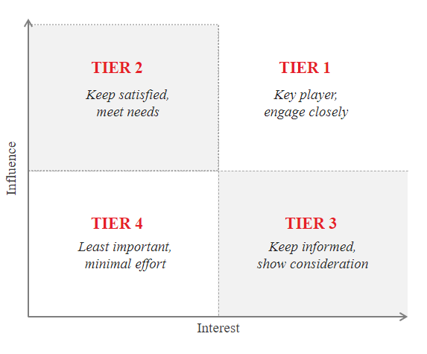
Influence / Interest Matrix
Map and Analyse
An Influence/Interest Matrix is used to map stakeholders. This gives a clear picture of the level of engagement required for each stakeholder and quickly highlights who the high-priority stakeholders are.
The following engagement level is a recommended starting point for each tier:
TIER 1 – Part of Project Steering Group (PSG). Ongoing engagement throughout the project at defined workshops e.g. identifying priorities and for delivery. Specific engagement plans developed as required.
TIER 2 – Participate in workshops and engage with the project at key milestones (if required). Potentially one-to-one contact during data collection stage and one-to-one interviews to be held with these stakeholders to gain further insight and understanding of priorities and delivery contributions.
TIER 3 and 4 – Potentially participate in workshops and engage with the project at key milestones (ad hoc basis e.g. delivery planning). Receive a direct invite to public consultation.

Slide 14
Stakeholder Mapping Template
Map and Analyse
The Stakeholder Mapping Template has been provided in the accompanying Excel document. This supports mapping the various stakeholder attributes outlined in the guidance and automatically generates an Influence/Interest Matrix based on scoring each stakeholder from 1-10.
How to use: The template is completed in two steps:
First a table is completed, which enables the stakeholders to be mapped to LHEES stages, considerations and level of involvement. In addition, the level of influence and interest is scored from 1-10 (with 10 being the highest).
The scored stakeholders are then automatically plotted on an Influence/Interest Matrix so that the priority level of engagement can be clearly seen.
Note: the stakeholder mapping and analysis should continue to be reviewed post-completion and on an ongoing basis
It is recommended the template is completed in a workshop setting with:
LHEES stakeholder engagement coordinator/practitioner
Support from strategic LHEES role for LHEES Considerations and scoring, and any internal governance groups that may have been established.

Slide 15
Stakeholder Mapping Template
Map and Analyse
Step 1: Stakeholder information is populated in the table and each stakeholder is scored on level of influence/interest
Considerations when scoring stakeholders on interest/influence:
Can they influence LHEES considerations/ final strategy?
Are they key providers of data/information?
Will they be affected by the outcomes of the LHEES?
Will they play a role in the delivery of the LHEES?
Are they already involved in areas of energy planning, energy efficiency and heat decarbonisation?

Slide 16
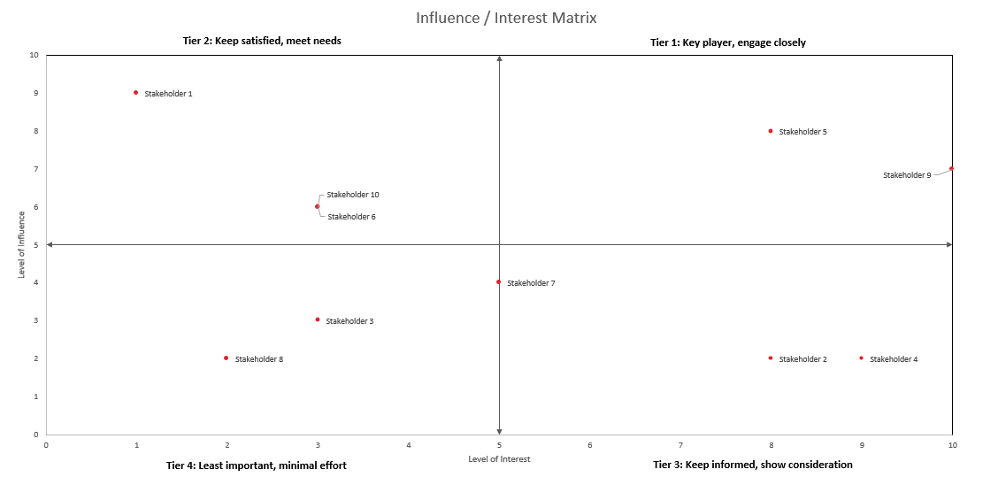
Example
Map and Analyse
Step 2: stakeholders are automatically plotted on the matrix

Slide 17
Plan

Slide 18
Guidance
Plan
An Engagement Plan is required to detail engagement activities throughout the full LHEES process. A timeline of the types of engagement that would be expected at each LHEES Stage is provided on the next page.
In addition, Engagement Plans should be created for some specific stakeholders to track engagement, where the engagement is key to the LHEES strategy/development (e.g. for some Tier 1 stakeholders or a specific heat network project).
The LHEES Methodology (section 3.1.2) specifies that the Engagement Plan should cover the following aspects:
Purpose of engagement
Frequency of engagement
Type of information required
Stakeholder’s priorities, interest and expectations for LHEES
Level of involvement with LHEES delivery

Slide 19
LHEES Engagement Timeline
Plan
Stakeholder engagement tasks
Workshop
One-to-one interviews
Consultation period
Stage 1: Key Activity
Stage 2: 1-2-1 Meetings
Stage 4: Workshop
Stage 7+8: 1-2-1 Meetings
Stage 7+8: Online session
Stakeholder Mapping and Engagement Planning
Engage with the Council to identify, map and prioritise key stakeholders.
Map stakeholder attendance against defined engagement activity.
Stakeholders: Council
Data Collection
Circulate a combined RFI for LHEES to enable the assembly of key datasets. If required, engage with stakeholders that own datasets and can support with data sharing.
Stakeholders: Council, RSL, DNO, EST and SGN
Delivery Area Generation
Interactive workshop to explore and discuss initial Delivery Areas and recommendations alongside the wider policy, strategy and delivery environment.
Stakeholders: Council, DNO and SGN + others from mapping
Consultation Period
Support the council in producing a communication strategy for the consultation process. The strategy will finalise who the Council will engage with, specifying the type and format of engagement.
Stakeholders: Council
Consultation Period
Online awareness-raising and Q&A session to support public consultation.
Stakeholders: Council, wider public and community groups
Report Review
Stage 1
Stage 2
Stage 3
Stage 4
Stage 5
Stage 6
Stage 7
Stage 8
Stage 1: Workshop
Stage 3: 1-2-1 Meetings
Stage 6: Workshop
Stage 7+8: Workshop
Objectives Setting
Drive engagement and awareness for the stakeholders, framing this around key questions and knowledge requirements that each of them has. Ensure stakeholders understand the role they will play in LHEES.
Stakeholders: All internal and priority external stakeholders
Baseline Feedback
Work closely with the Council to visualise baseline information. The output report should be engaging and compatible with the Councils IT system.
Engage specifically on HN zoning, as per LHEES Guidance/Methodology.
Stakeholders: Council + others from mapping
Baseline report submission
Finalisation of Delivery Areas / Delivery actions
Set out and ask for feedback on the finalised Delivery Areas (incorporating analysis to date). Explore key actions, enablers and challenges to support content for LHEES Strategy and Delivery Plan.
Stakeholders: Council, DNO and SGN + others from mapping
Consultation Workshop
Workshop with Council Steering Group and attendees from Stage 1 Workshop to present the draft Strategy and Delivery Plan for discussion and feedback
Stakeholders: Council and Steering Group (see workshop 1)

Slide 20
Stakeholder Engagement and Management Plan Template
Plan
A Stakeholder Engagement and Management Plan Template has been provided in the accompanying Excel document. This can be completed by LHEES stage and by stakeholder to plan and track the engagement throughout the LHEES process.
How to use:
Plan by LHEES Stage: Complete the template to map out key engagement events which will occur at each stage of the LHEES process. This includes activity name, stakeholders involved, type of engagement, purpose and outputs.
Plan by Stakeholder: Complete for the high-priority stakeholders if there is a need to plan engagement in more detail. The first half of the template summarises the stakeholder details, engagement tier, LHEES priorities and frequency of engagement. The second half of the template can be used to plan engagement activities including the purpose and information required. It is suggested that individual plans may only be required for Tier 1 and Tier 2 stakeholders.
It is recommended these templates are completed in a workshop setting with:
LHEES stakeholder engagement coordinator/practitioner
Updated with stakeholders input to incorporate feedback on timescales and level/type of engagement required.

Slide 21
Template Example
Plan
Plan by LHEES Stage: For main engagement activities at each LHEES stage (see engagement timeline)

Slide 22
Template Example
Plan
Plan by Stakeholder: For specific stakeholders where engagement needs to be planned more closely

Slide 23
Engage

Slide 24
Guidance
Engage
Once stakeholders have been identified, mapped and engagement plans set out early in the LHEES process, stakeholder engagement activities should help to build up a picture of the opportunities, constraints, challenges, and need for further engagement.
A guide to facilitating workshops has been developed alongside to enable LA’s to get the most out of the engagement sessions (Workshop Facilitation Guidance).
As an iterative process, it is important to continuously monitor and record engagement, making updates as new stakeholders are identified.
Engagement Activity
Record Outputs
Feed outputs into LHEES
No further engagement required – ensure engagement and actions are logged
Plan engagement activity
Further engagement required
Map new stakeholder
New stakeholder identified

Slide 25
Guidance
Engage
Guidance to support continuous review and analysis of stakeholders and engagement plans:
Key stakeholders should be brought together from the outset and should be engaged at each main LHEES Stage.
The engagement checklist provided in the LHEES Methodology (section 3.1.3 - also see the Workshop Facilitation Guidance) can be used to guide engagement sessions. Questions and responses from engagement sessions should be reviewed to consider whether updates are needed for subsequent sessions.
Log all engagement activities and outputs – the Stakeholder Engagement and Management Plan Template can be used to help maintain clear records over time. Alternatively, a quick record of engagement can be noted against stakeholders listed in the Stakeholder Mapping Template or Policy and Engagement Template.
Regularly feedback outputs to the LHEES team for consideration and share updates with stakeholders in a timely manner.
Consider whether further engagement sessions are necessary and update the Engagement Plans as needed. Further engagement could look to ensure that the information and data received has been interpreted correctly, as well as ensuring live or future projects are considered in the LHEES Delivery Plan where relevant.
Add new stakeholders as they are identified throughout LHEES Stages, ensuring they are mapped and included in the appropriate engagement plans.

