Slide 1
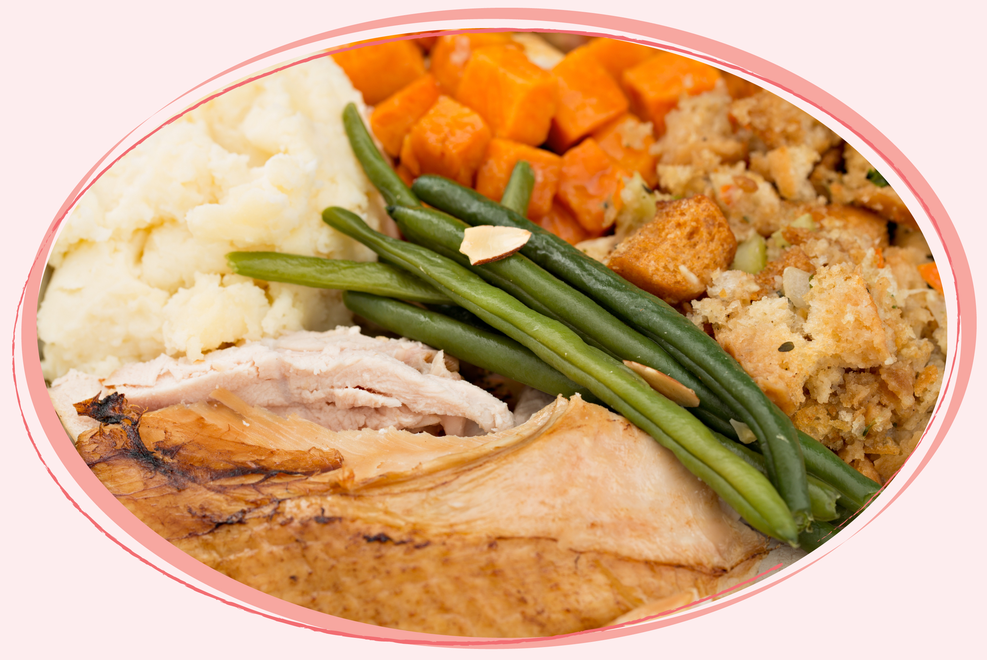
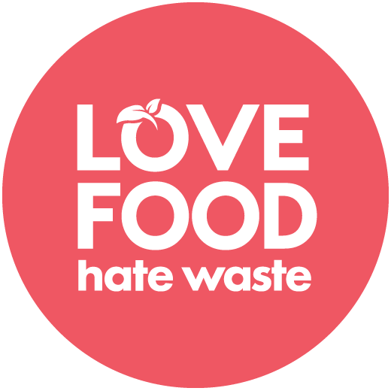
Leftover meat and vegetables from an everyday meal...

Slide 2
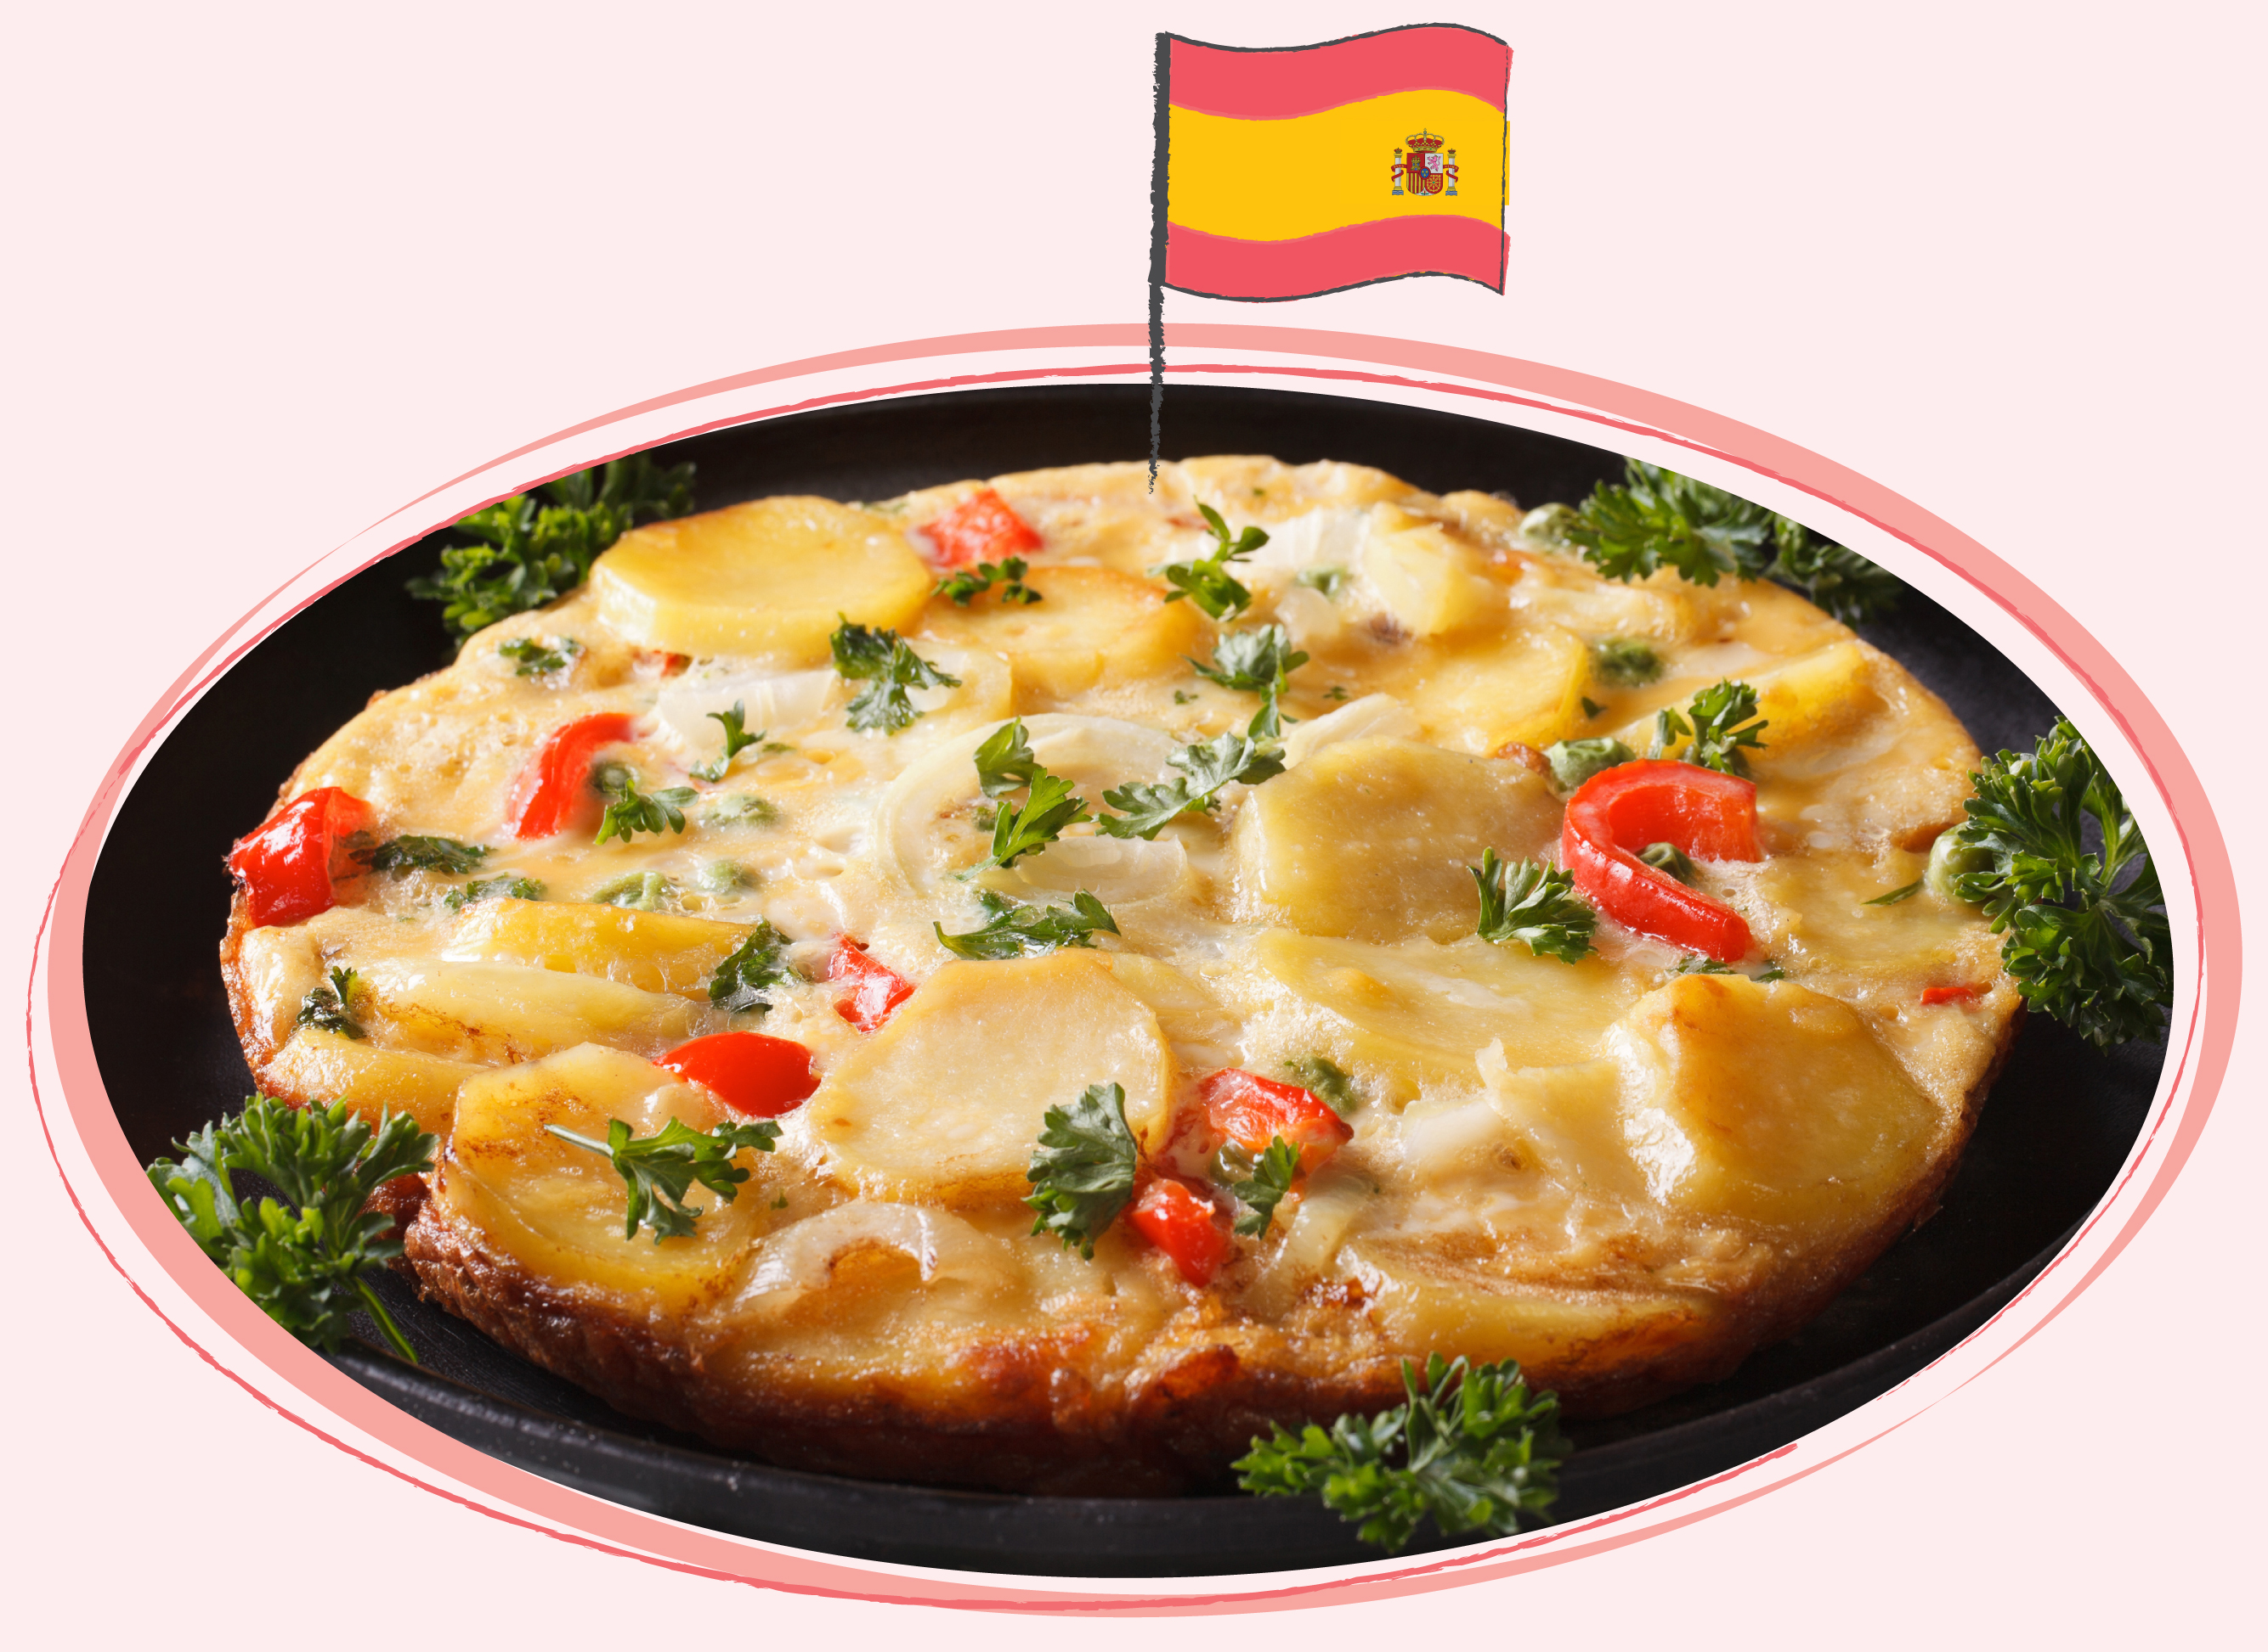
...can be transformed into a frittata from Spain…
…which is like a potato and onion omlette often including meat.

Slide 3
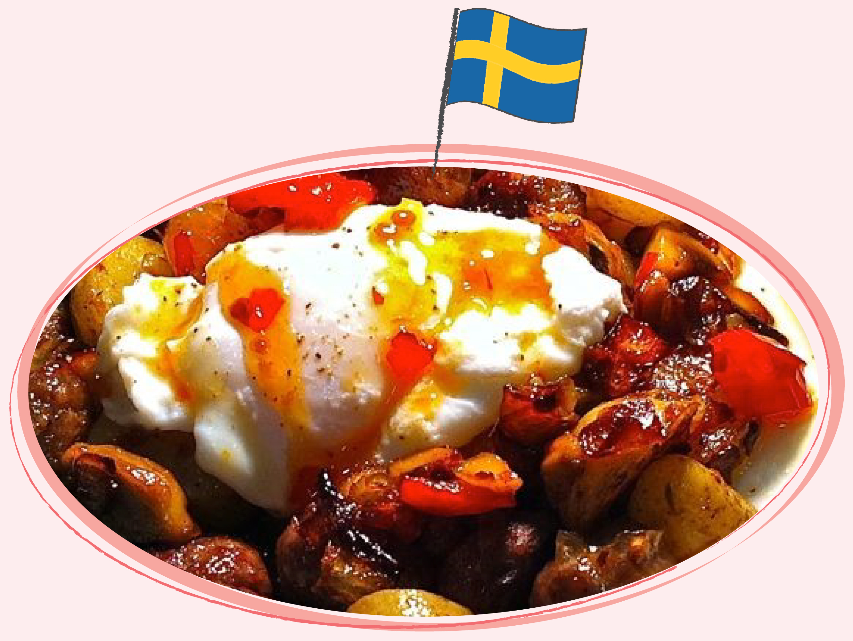
… or Pytt i Panna a traditional Swedish dish made from leftover meat and vegetables...
...which are fried and served with egg on top.

Slide 4
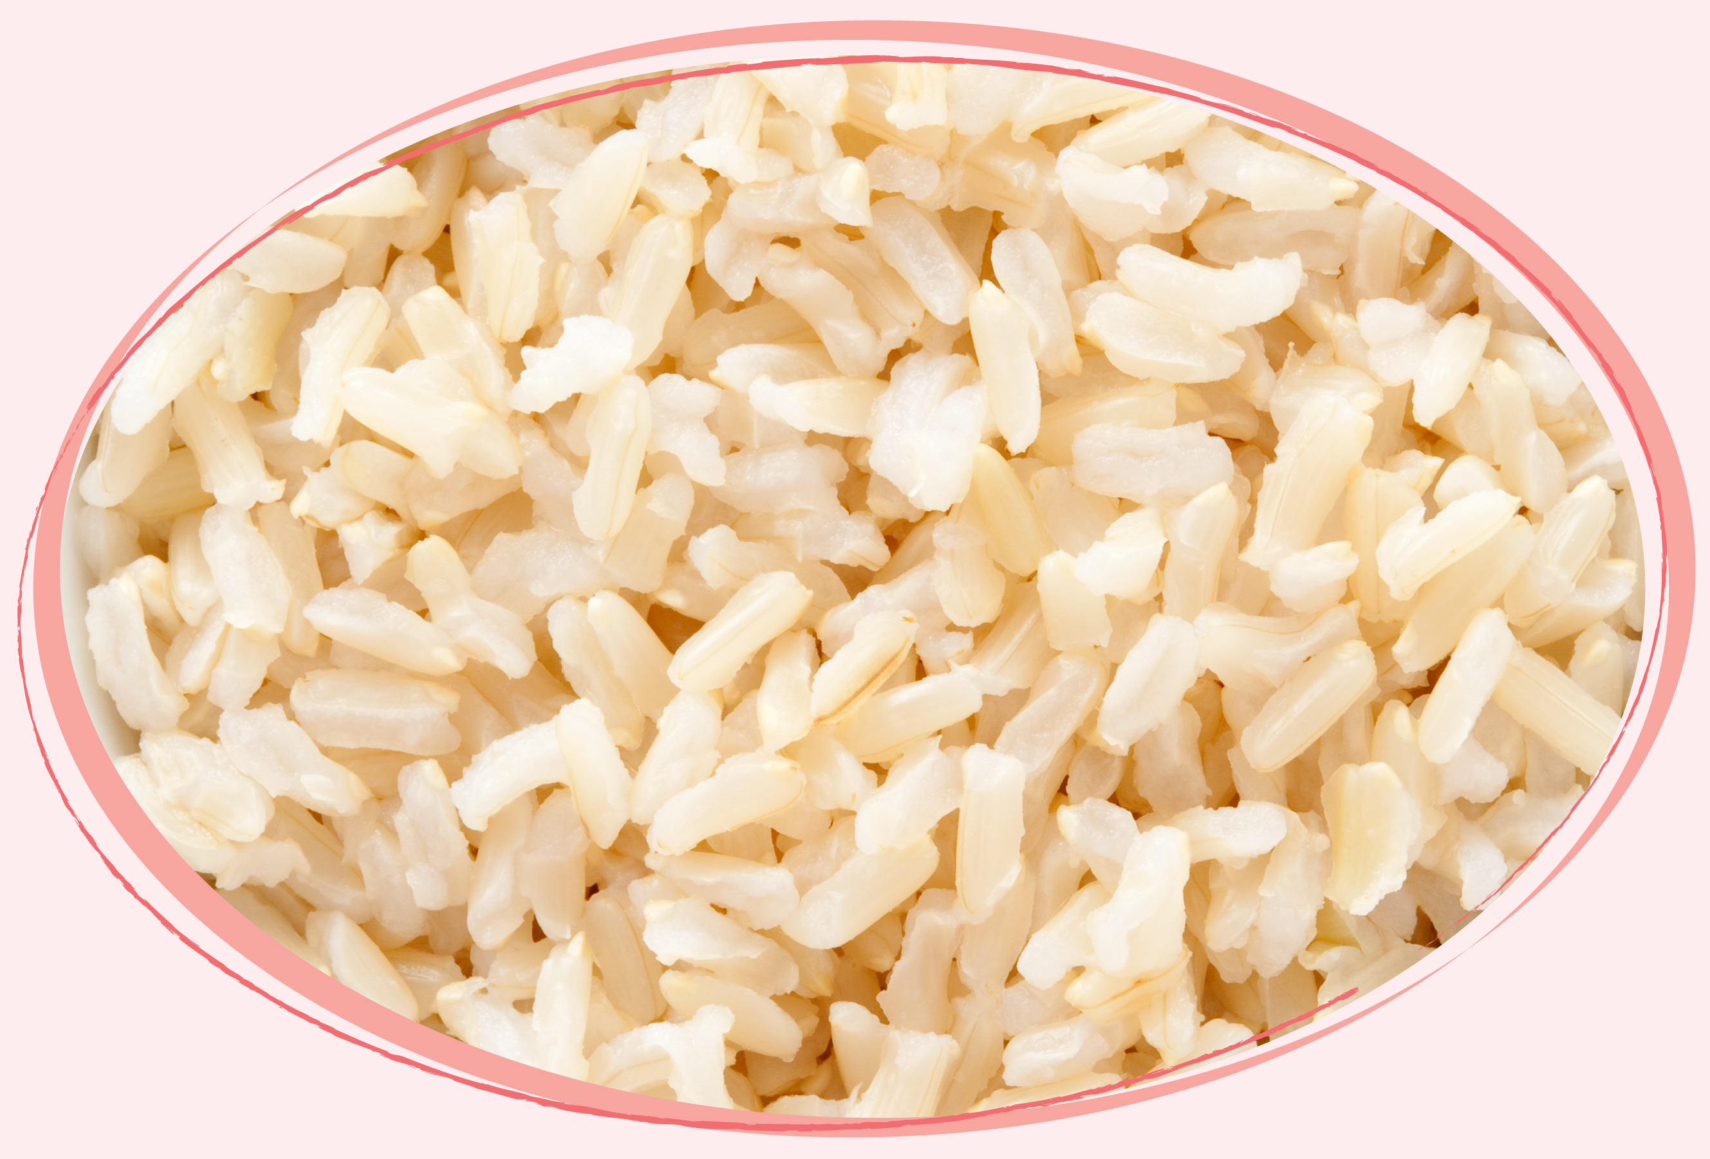
Leftover rice...

Slide 5
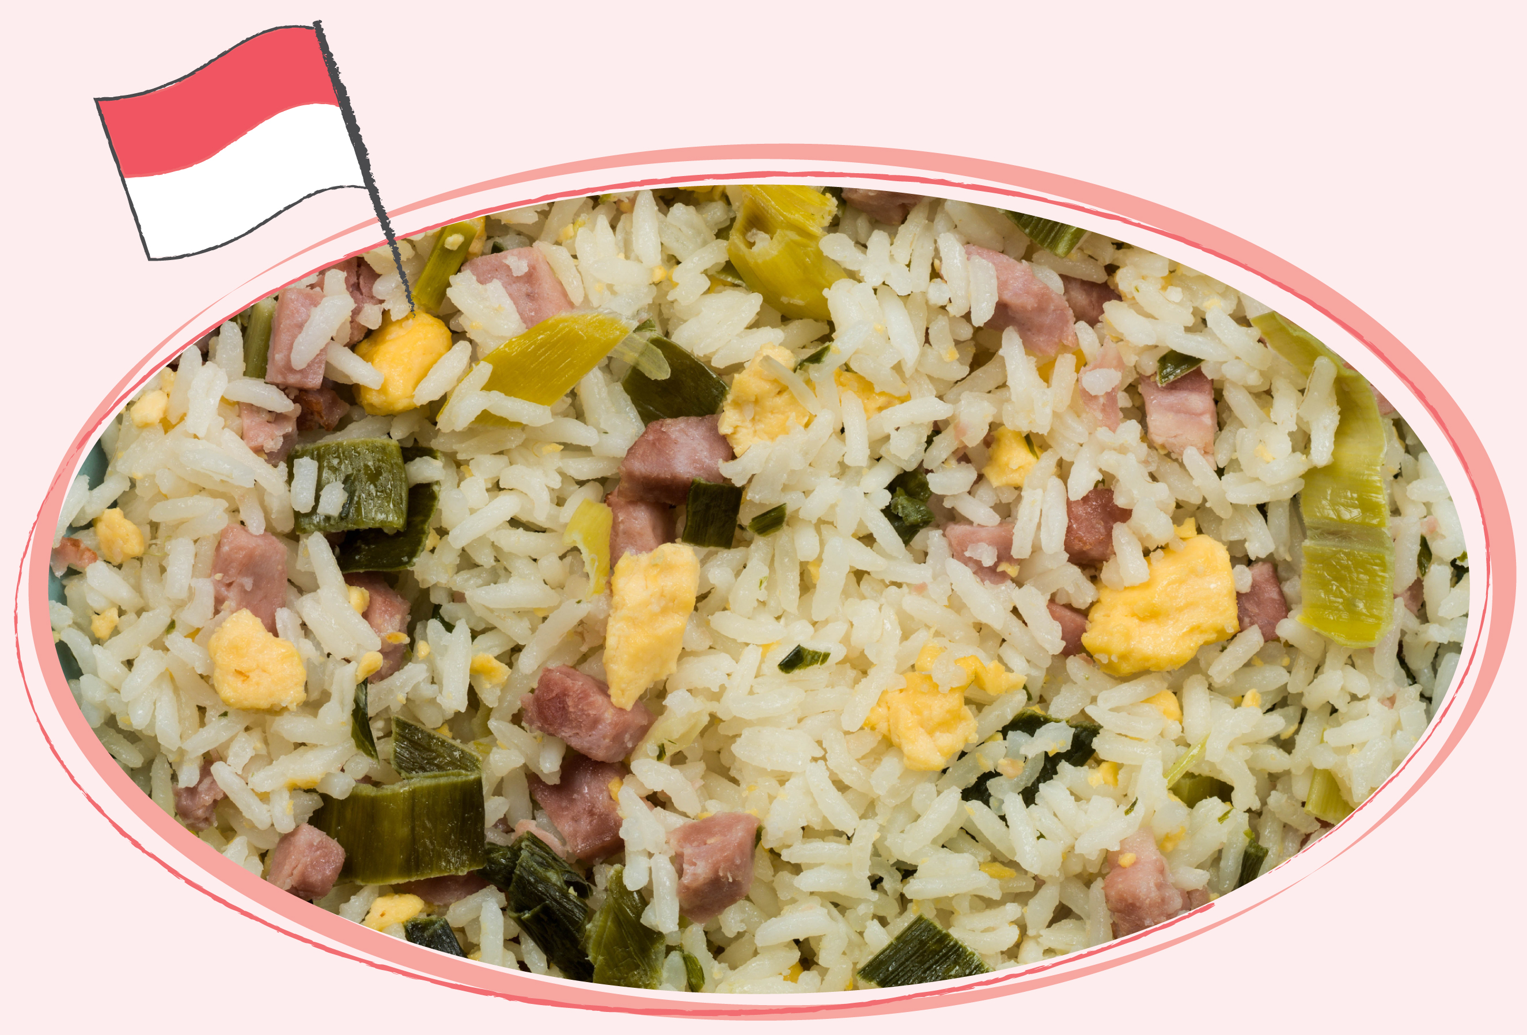
…can be reimagined into Nasi Goreng from Indonesia...
...a dish of re-fried
rice with cabbage,
carrot and egg...
...it can also include meat.

Slide 6
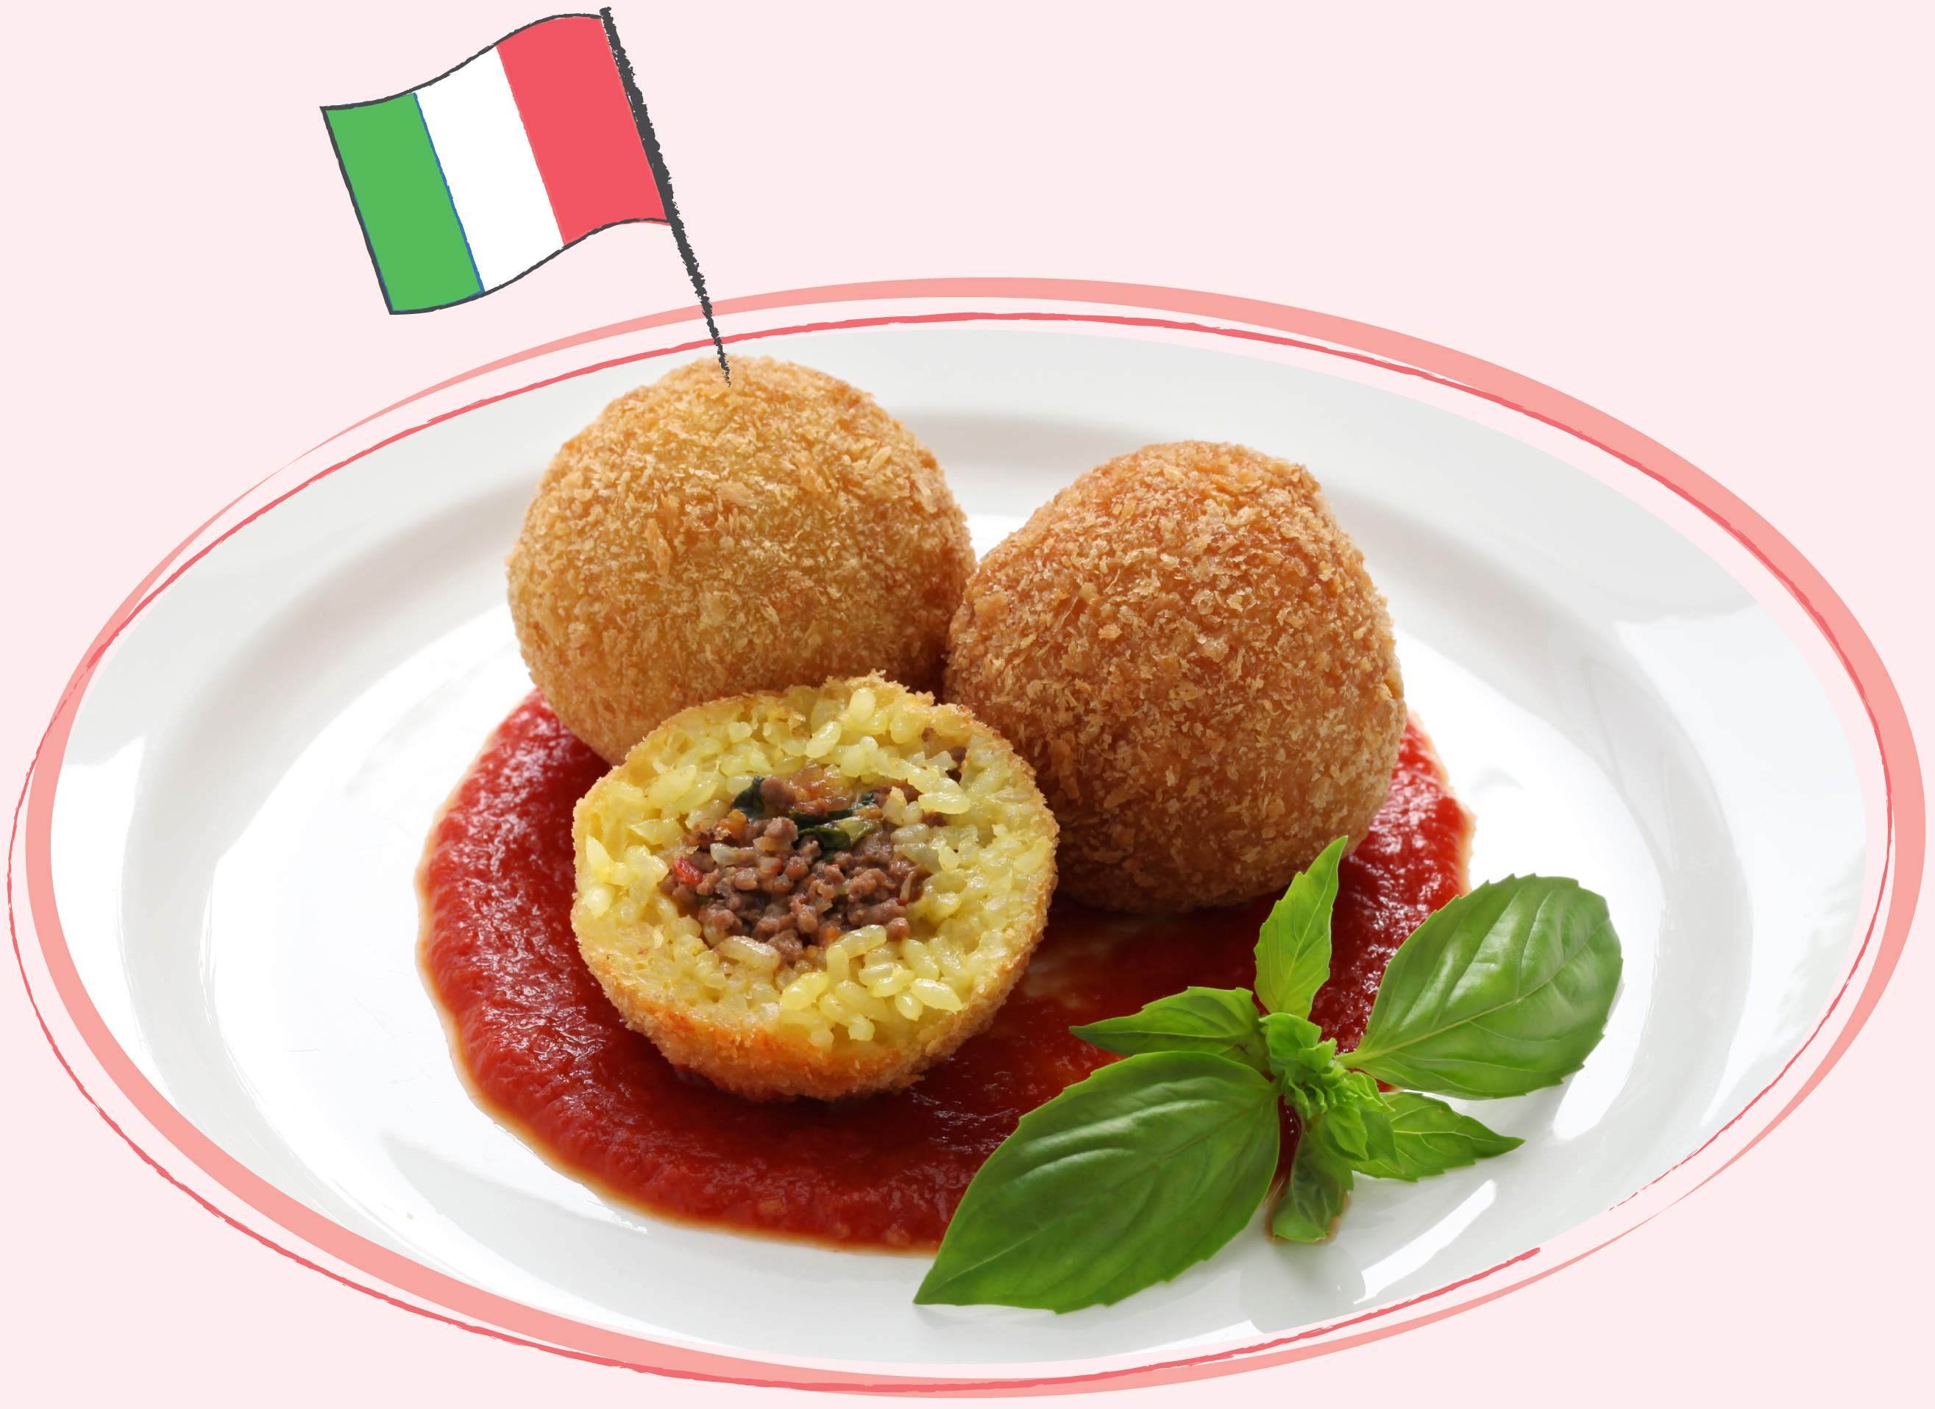
…or in Italy it is turned into Arancini...
...crispy fried balls of rice often with cheese or meat in the middle.

Slide 7
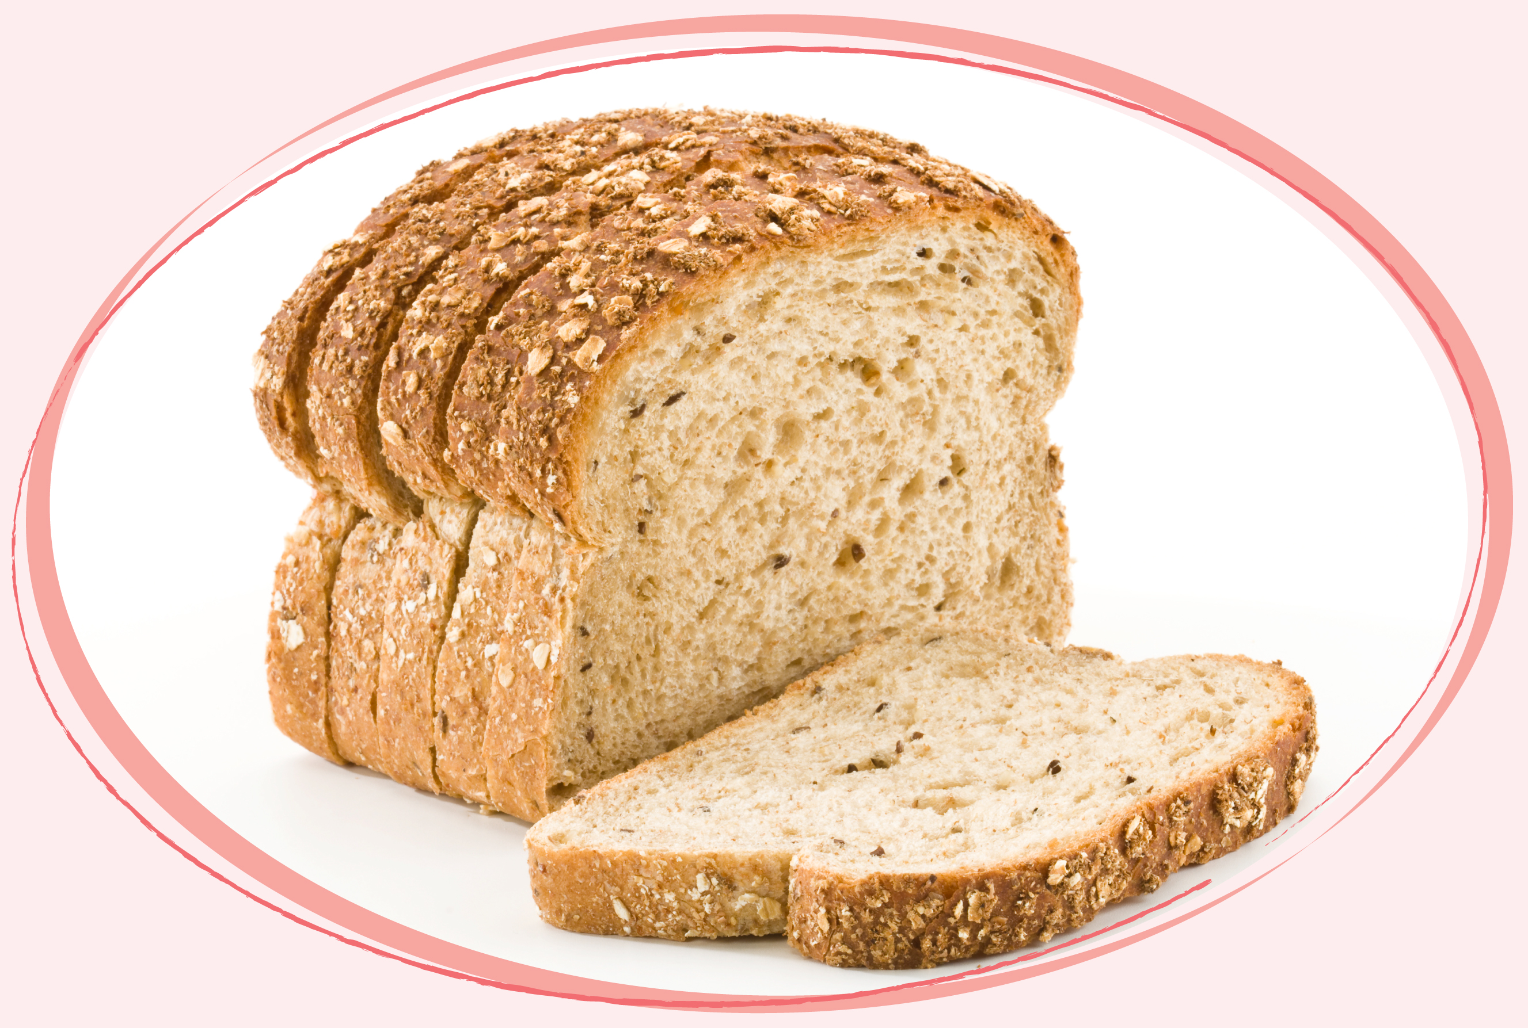
Leftover bread...

Slide 8
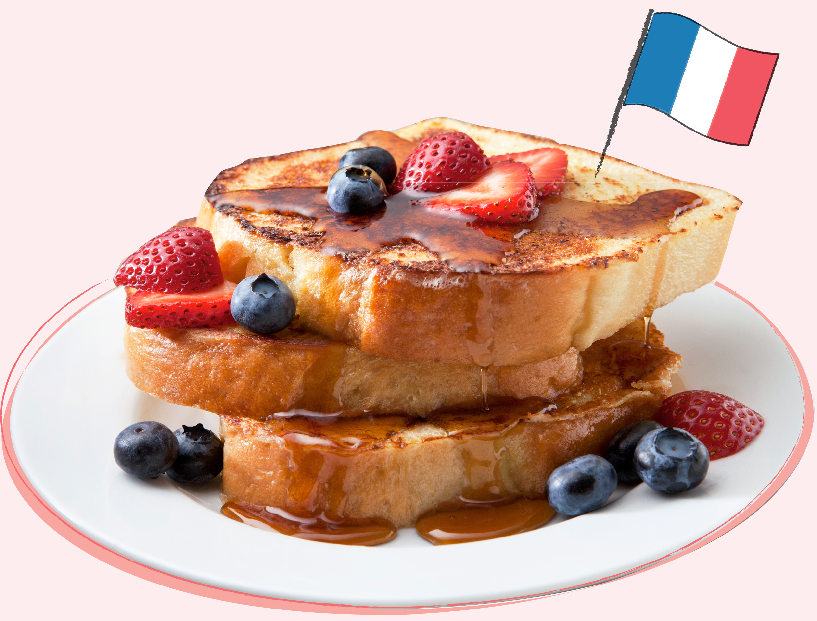
...can be transformed into Pain Perdu or ‘eggy bread’ from France...
...which can be sweet or savoury.

Slide 9
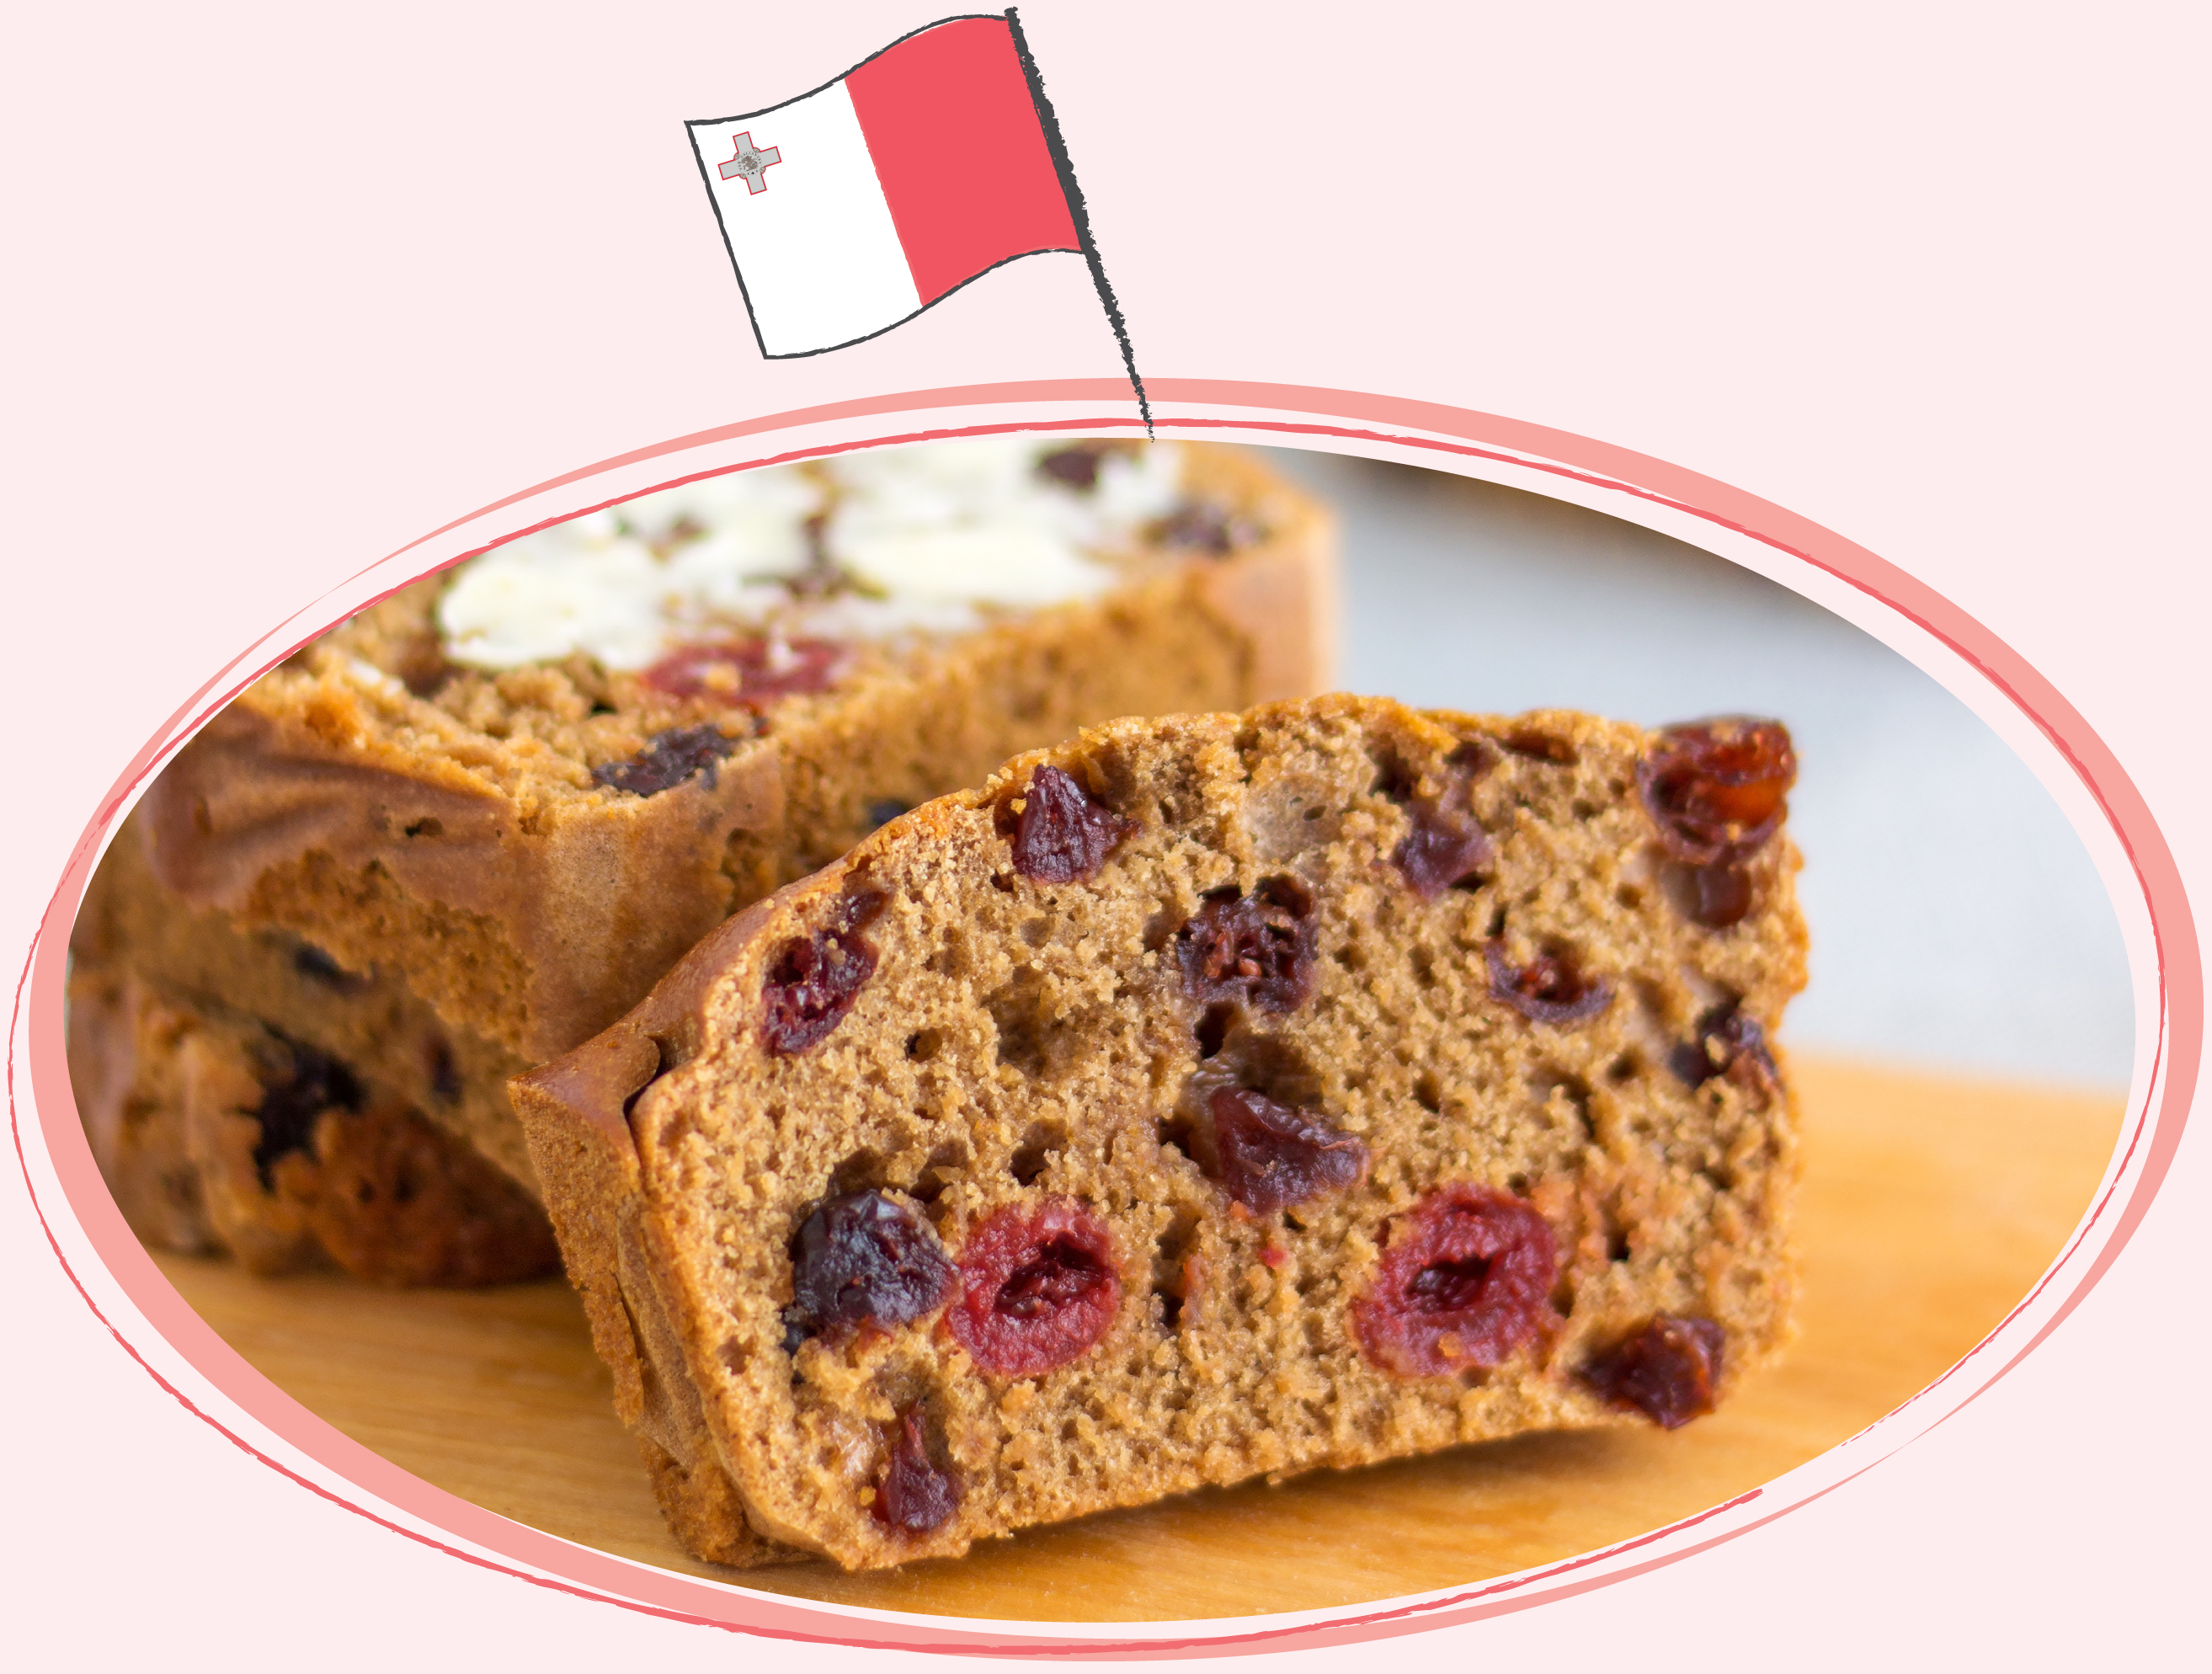
...or Pudina tal-Hobz a bread pudding…
...using cocoa and raisins from Malta.

Slide 10
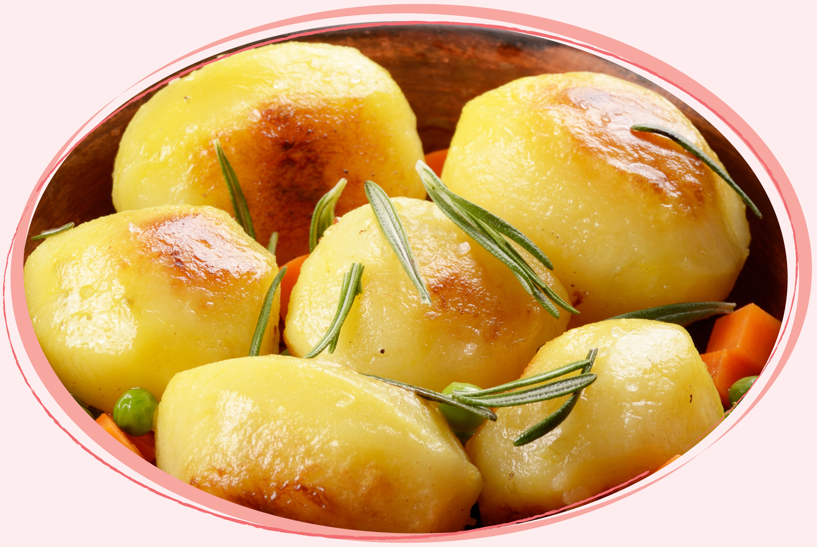
Leftover cooked potatoes…

Slide 11
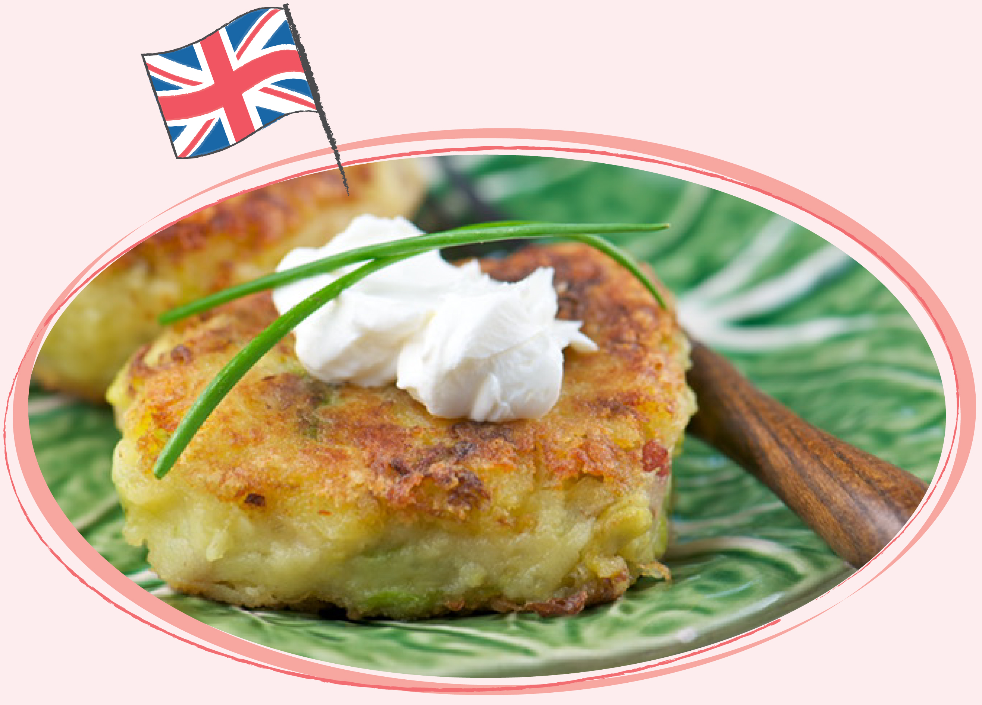
...can been reimagined into Bubble & Squeak from the UK...
... Using Sunday roast leftovers.

Slide 12
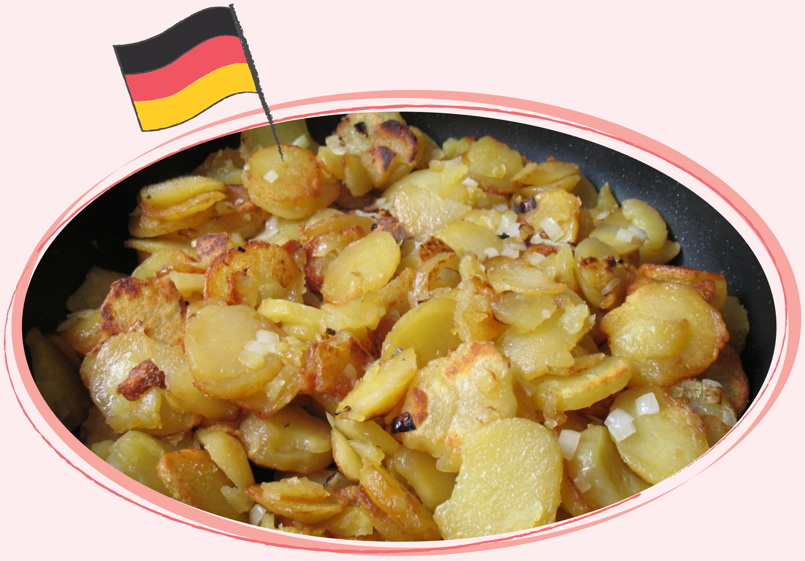
...German Bratkarfoffeln or 'pan fried potatoes'...
...made from leftover potatoes, bacon and onion.

